Slide 1
The programming process
A program performs computations on data. The purpose of data is to represent meaningful information. What information does this problem contain? How do we represent this information as data? What computation needs to be performed on this data to produce new meaningful information?

Slide 2
documentation
software documentation - information about various aspects of the intended operation of the programming language

Slide 3
glossary
function: a mathematical object that takes in some inputs and produces an output
domain: the type of data that a function expects
range: the type of data that a function produces
contract: a statement of the name, domain, and range of a function
consume: to take in values to compute an expression
produce: to compute a value from an expression

Slide 4
Böhm and Jacopini's insight:
3 actions needed to do anything
sequence:
first do this; then do that
selection:
IF such-&-such is the case,
THEN do this
ELSE do that
repetition:
WHILE such & such is the case DO this

Slide 5
Functional vs. Procedural Languages
A. Procedurals languages mirror machine code
B. Functional programs allow you to program what you mean
C. Procedural languages are more common in the software engineering industry

Slide 6
How do compilers and interpreters help develop programs?
A. They give the programmer access to specific functions designed for a specific purpose.
B. They make programs run faster.
C. They allow programmers to write programs without using machine code.

Slide 7
glossary cont’
expression: a computation written in the rules of some language (such as arithmetic, code, or a Circle of Evaluation)
function: a mathematical object that takes in some inputs and produces an output
interactions window: the text box at the top of the Editor (DrRacket or WeScheme), where we enter expressions to evaluate
legal expression: code that follows the Code Rules for a language
mathematical expression: a computation in arithmetic
programming language: a set of rules for writing code that a computer can evaluate

Slide 8
What is a program
a program performs computations on data
Try to think of a program that doesn’t fit this definition.

Slide 9
Leibniz's, Boole's, Turing's, Shannon's, & Morse's insight:
There are only 2 objects that a computer has to deal with in order to represent "anything."
What are they?

Slide 10
Alan Turing's insight: 4 actions a computer must do
* move left one location
* move right one location
* read symbol at current location
* print 0 at current location
* print 1 at current location

Slide 11
Glossary
apply: use a given function on some inputs
arguments: the inputs to a function; expressions for arguments follow the name of a function
circle of evaluation: a diagram of the structure of an expression (arithmetic or code)
definitions window: the text box at the top of the Editor (DrRacket or WeScheme), where definitions for values and functions are written
editor: software in which you can write and evaluate code
evaluate: perform the computation in an expression, producing an answer
evaluates to: the result of computing an expression

Slide 12
glossary cont’
error message: information from the computer about errors in code
image: a type of data for pictures
identifier: how we refer to a function or value defined in a language (examples: +, *, star, circle)
string: any sequence of characters between quotation marks (examples: "hello", "42", "this is a string!")
type: refers to a general kind of data, like Number, String, Image, or Boolean
value: a specific piece of data, like 5 or "hello"

Slide 13
Review the Rules for Brainstorming
1. Defer Judgment. Don’t block someone else’s idea if you don’t like it…put it on the whiteboard and maybe you’ll be able to build on it later.
2. Go for quantity. Getting to 100 ideas is better than 10, no matter what you initially think about the “quality”. Try setting a goal for the number of ideas you’ll get to in a certain amount of time to provide some stoke.
3. One conversation at a time. When different conversations are going on within a team, no one can focus.
4. Be visual. Sketch your ideas out for your teammate. It will communicate them more clearly than words alone, plus you might inspire some crazy new ideas.
5. Headline your idea. Make it quick and sharp, then move on to the next one.
6. Build on the Ideas of others. This leverages the perspectives of diverse teams and can be especially useful when you feel like you’re stuck.
7. Stay on topic. Your idea for an edible cell phone is awesome, but not during a brainstorm on making opera more exciting for children.
8. Encourage wild ideas. The crazier the better…you never know where your team might be able to take it. (See #1 and #6).

Slide 14
iteration, n.
1. the act of repeating; a repetition.
2. a problem-solving or computational method in which a succession of approximations, each building on the one preceding, is used to solve the problem

Slide 15
The Big Ideas of CS Principles
Creativity
Abstraction
Algorithms
Data
Programming
Internet
Global Impact

Slide 16
Brainstorming
What sorts of things could people make with computers?
Write as many ideas as you can in 1 minute.

Slide 17
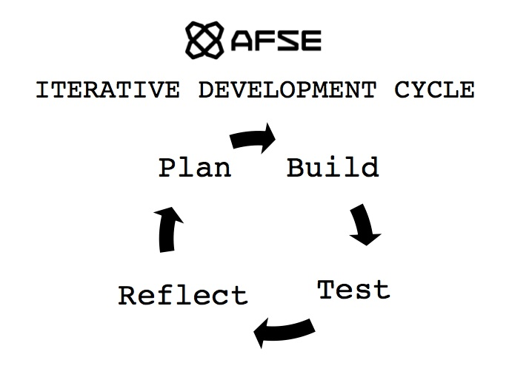

Slide 18
iterate
the act of repeating a process with the aim of reaching a goal
the act of repeating a process with the aim of reaching a goal

Slide 19
formal vs. informal language

Slide 20
How are programming languages similar to natural languages?
defining a variable is like defining a noun
defining a function is like defining a verb

Slide 21
Algebra
just another language

Slide 22



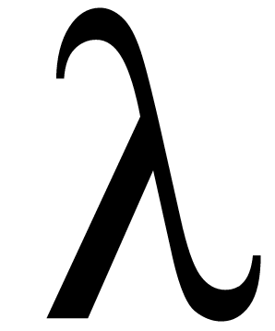
many names
Racket - the actual language we will be using
WeScheme - a cloud-based programming environment for Racket
Bootstrap - a curriculum for teaching mathematics with Racket
Scheme - the parent of Racket

Slide 23
What is research?
Can we learn math from computer programming?
What is a phD?

Slide 24
Style
"You know you are done when your code is as beautiful as the flag it creates," Emmanuel Schanzer, creator of WeScheme

Slide 25
Human - Computer Interface
; circle takes a radius a mode and a color and produces a circle image
; circle : Number String String -> Image
name domain range
S
Human
Computer

Slide 26
Functions and Types

Slide 27
Four types
Numbers
Strings
Booleans
Images

Slide 28
Numbers
4
0.1
pi
⅓

Slide 29
Strings
“title”
“name”
“hello”
“21”

Slide 30
Booleans
true
false

Slide 31
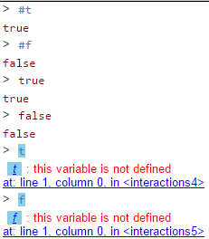
Booleans
true
false

Slide 32

Images

Slide 33
Functions that combine data
Numbers
(+ 3 2)

Slide 34
Functions that combine data
Numbers
(+ 3 2)
5

Slide 35
Functions that combine data
Strings
(string-append “hello_” “world”)

Slide 36
Functions that combine data
Strings
(string-append “hello_” “world”)
“hello_world”

Slide 37
Functions that combine data
Booleans
(and true false)

Slide 38
Functions that combine data
Booleans
(and true false)
false

Slide 39
Functions that combine data
Images
(above )

Slide 40
Functions that combine data
Images
(above
)

Slide 41
Functions and Types
Humans
Computer

Slide 42
Angles
Data Types | Functions that produce this data type | Functions that use this data type as arguments
numbers | +, -, /, *, string-length | circle, star, rectangle
strings | string-append | string-length
images | circle, place-image, star | above, below, beside
angles |  | rotate

Slide 43
Notes 2/5 - Data Types Table
Copy this table into your notes. We will use it today in our lesson
Data Types | Functions that produce this data type

Slide 44
Types | Functions

Slide 45
Types | Functions
Number | + - * / sqr sqrt expt

Slide 46
language table
Data Types | Functions
Notes:
What types of data have we worked with so far? What are some functions that work on those data types?

Slide 47
numbers
everything you already think of

Slide 48
what is the difference between a type and a value?
Units in science, sets/intervals in math, datatypes in computer science.
We need to be able to talk about ideas in general terms
Types are general
Values are specific

Slide 49
Circles of Evaluation
Function Names: or identifiers, are like the verbs in a sentence, they are written above the line.
place-image
circle
square
25
100
50
"solid"
"red"
100
"solid"
"blue"
Arguments: like the object of a verb, arguments are given to functions to help functions do their work. They are written below the line.

Slide 50
Circles of evaluation
(* 5 10)
*
5
10

Slide 51
Circles of evaluation
(circle 50 “solid” “red”)
circle
50
“solid”
“red”

Slide 52
name: or the identifier, always comes right after the opening parenthesis
arguments: what the function needs to do its job
(circle 50 "solid" "red")
each expression has an open and close parenthesis

Slide 53
parts of a expression
arguments
name
(circle 50 "solid" "red")

Slide 54
parts of a function
(circle 50 "solid" "red")

Slide 55
notes 1/4
definitions window: the text box at the top of the Editor (DrRacket or WeScheme), where definitions for values and functions are written
identifier: how we refer to a function or value defined in a language (examples: +, *, star, circle)
parametrization: the process of deciding and defining the parameters

Slide 56
composition of expressions
to consume the result of one expression as the argument of another

Slide 57
Arguments vs. Parameters
When we define a function or discuss its contract we refer to the functions parameters. Parameters are general.
Here is the contract for a new function:
; rectangle: Number Number String String -> Image
Here is an example of the function being used
(rectangle 300 400 “solid” “blue”)
When we use a function we are applying that function to its arguments. Arguments are specific values.

Slide 58
name: or the identifier, always comes right after the opening parenthesis
arguments: what the function needs to do its job
(circle 50 "solid" "red")
each function has an open and close parenthesis

Slide 59
Circles of Evaluation
Function Names: or identifiers, are like the verbs in a sentence, they are written above the line.
place-image
circle
square
25
100
50
"solid"
"red"
100
"solid"
"blue"
Arguments: like the object of a verb, arguments are given to functions to help functions do their work. They are written below the line.

Slide 60
Evaluating expressions
What would Racket say to the following lines of code?
> (+ 1 4)
> (/ 4 2)
> (- 0 9)
> (* 3 4)

Slide 61
Image Functions
What do we need to know to write image functions in Racket?

Slide 62
parts of an expression
arguments
name
(circle 50 "solid" "red")

Slide 63
Write the code for this circle of evaluation.
define
gtrc
put-image
triangle
circle
25 "solid" "green"
50 "solid" "red"
50 50

Slide 64
circles of evaluation
Math
Circle of Evaluation
Racket Code

Slide 65
composition of functions: putting one function inside of another
Interpret the following line of code.
(* 5 (+ 3 2))
...and this one?
(rotate 45
(triangle 50 "solid" "green"))
How many parameters does rotate have? How do we answer this question?

Slide 66
Formal Language
What do we need to know to write expressions in WeScheme?

Slide 67
expression
anything that can be evaluated

Slide 68
Composition of Functions
How can one expression be the argument of another?
(+ 3 (* 5 7))
(rotate 45 (square 50 “solid” “red”))

Slide 69
Write the contract for
(circle 50 "solid" "red")

Slide 70
Draw the circle of evaluation
(put-image
(circle 50 “solid” “red”)
100 0
(square 100 “solid” “blue”))

Slide 71
Image Primitive Contracts
; circle : Numer String String -> Image
; star : Number String String -> Image
; rectangle : Number Number String String -> Image

Slide 72
Image Combiner Contracts
; above : Image Image ... -> Image
; beside : Image Image … -> Image
; overlay : Image Image ... -> Image
; put-image : Image Number Number Image -> Image

Slide 73
Image Property Contracts
; image-height : Image -> Number
; image-width : Image -> Number

Slide 74
more about contracts
; rotate: angle image -> image
what goes into the function is what the function consumes. This is called the domain.
What comes out of the function is what the function produces. This is called the range.

Slide 75
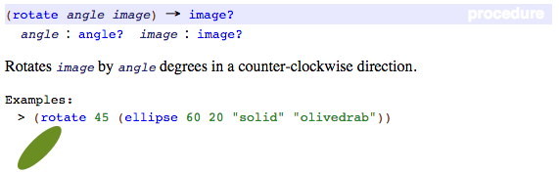
Contract Review
; rotate: angle image -> image
; consumes a number between 1 and 360 and produces an image rotated counterclockwise
This page from the documentation becomes the entry in our contract library below.
Compare them to review how to write a contract.

Slide 76
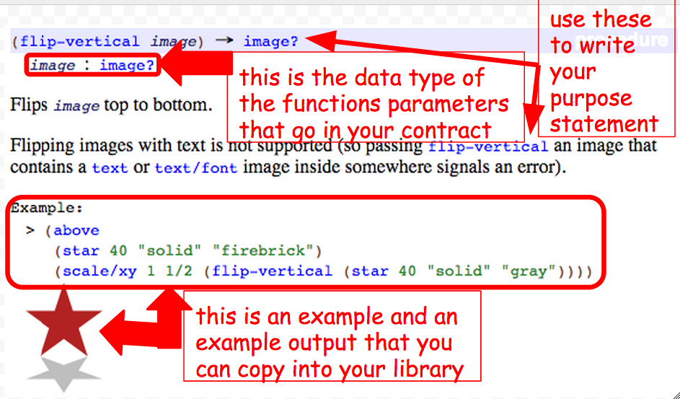
Documentation to Contracts

Slide 77
Contracts - Values vs. Types
Here is the contract for a new function:
; rectangle: Number Number String String -> Image
Here is an example of the function being used
(rectangle 300 400 “solid” “blue”)
Contracts refer to a parameters type. Types are general.
Functions are applied an arguments values. Values are specific.

Slide 78
+
Here is the contract for a new function:
; +: Number Number -> Number
Here is the purpose statement for the function:
; + consumes two or more numbers and produces the sum of those numbers

Slide 79
Here is the contract for a new function:
; rectangle: Number Number String String -> Image
Here is the purpose statement for the function:
; consumes a width, height, mode, and ; color and produces an rectangle

Slide 80
Describe how the function + works.

Slide 81
contracts (API)
(circle radius mode color)
; circle : number string string -> image
name domain range

Slide 82

expectation
What will the Racket code
(circle 50 "solid" "red") return?
Is (circle 50 "solid" "red") a contract or an example?

Slide 83
make a connection
can you match each part of the contract with part of the example?
; circle : number string string -> image
(circle 50 "solid" "red")

Slide 84
nested place-image functions
What is the domain of place image?

Slide 85
Contracts
How do we create our library of functions?

Slide 86
Contracts Day 2
How do we create our library of functions?

Slide 87
additional functions
you are required to learn these additional functions and enter them into your contract library
string-length
image-width
image-height
bitmap/url
rotate
scale
scale/xy
flip-vertical
flip-horizontal

Slide 88
Given an example write the contract
(and true true)
(circle 59 “solid” “red”)
(+ 54 30)
(+ 5 (* 4 3))
(string=? “ab” “bc”)

Slide 89
Pair programming task 1
Write an expression to display the following image.
Bind the expression to a constant and evaluate it in the REPL

Slide 90
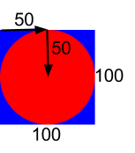
connect each argument to the diagram
#Example
EXAMPLE = place-image(
circle(50, “solid”, “red”),
50, 50,
rectangle(100, 100, “solid”, “blue”))

Slide 91
connect each argument to the diagram
include image
#Example
EXAMPLE = I.place-image(
I.circle(50, “solid”, “red”),
50, 50,
I.rectangle(100, 100, “solid”, “blue”))

Slide 92
place-image review
2
1/3
1
1/4

Slide 93
notes 2/4 - Copy the example into your notebook, type the code into WeScheme and draw a picture of the output.
(place-image
(circle 25 “outline” “yellow”)
0 0
(rectangle 100 50 “solid” “green”))

Slide 94
place image takes 4 arguments
(place-image
(circle 50 “solid” “red”)
25 100
(square 100 “solid” “blue”))
Argument 1
Arg 2
Arg 3
Argument 4

Slide 95
What is the data type of the 1st argument?
(place-image
(circle 50 “solid” “red”)
25 100
(square 100 “solid” “blue”))
image
Arg 2
Arg 3
Argument 4

Slide 96
what other expressions could be Argument 1?
(place-image
(place-image
IMAGE1 x y IMAGE2)
25 100
(square 100 “solid” “blue”))
Arg 2
Arg 3
Argument 4

Slide 97
What is the data type of the 3rd argument?
(place-image
(circle 50 “solid” “red”)
25 100
(square 100 “solid” “blue”))
Argument 1
Arg 2
number
Argument 4

Slide 98
what is the data type of the 3rd argument?
(place-image
(circle 50 “solid” “red”)
25 (* (+ 6 4) 100)
(square 100 “solid” “blue”))
Argument 1
Arg 2
Argument 4

Slide 99
Think deeper
If the range of a place-image function is an image, could one place image expression be the argument of another place-image expression?

Slide 100
notes 1/4 - place-image example
(place-image
(circle 50 “solid” “red”)
25 100
(square 100 “solid” “blue”))

Slide 101
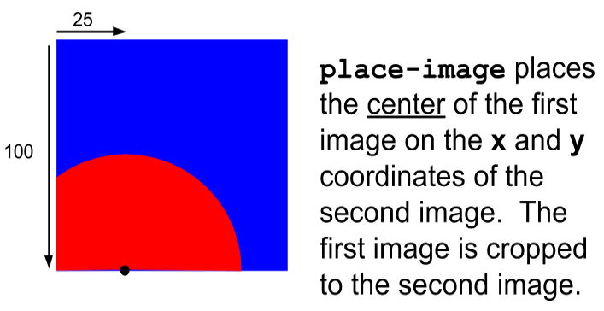
notes 3/4
which evaluates to...

Slide 102
Example 1
(place-image
(circle 50 “solid” “red”)
25 100
(square 100 “solid” “blue”))

Slide 103
Example 1
(place-image
(circle 50 “solid” “red”)
25 100
(square 100 “solid” “blue”))

Slide 104
place-image circle of evaluation
place-image
circle
50 “solid” “red”

Slide 105
place-image circle of evaluation
place-image
circle
50 “solid” “red”
25
100

Slide 106
place-image circle of evaluation
place-image
circle
square
50 “solid” “red”
25
100
100 “solid” “blue”
number
number
image
image

Slide 107
origin (0, 0) - top left corner
which evaluates to...

Slide 108
origin (0, 0) - top left corner
which evaluates to...

Slide 109
What is the data type of the 1st argument?
(place-image
(circle 50 “solid” “red”)
25 100
(square 100 “solid” “blue”))
Argument 1
Arg 2
Arg 3
Argument 4

Slide 110
What is the data type of the 1st argument?
(place-image
(circle 50 “solid” “red”)
25 100
(square 100 “solid” “blue”))
Argument 1
Arg 2
Arg 3
Argument 4

Slide 111
what other expressions could be Argument 1?
(place-image
(place-image
IMAGE1 x y IMAGE2)
25 100
(square 100 “solid” “blue”))
Argument 1
Arg 2
Arg 3
Argument 4

Slide 112
What is the data type of the 3rd argument?
(place-image
(circle 50 “solid” “red”)
25 100
(square 100 “solid” “blue”))
Argument 1
Arg 2
Arg 3
Argument 4

Slide 113
what other expressions could be passed as the third argument?
(place-image
(circle 50 “solid” “red”)
25 100
(square 100 “solid” “blue”))
Argument 1
Arg 2
Arg 3
Argument 4

Slide 114
three new functions
scale/xy
text
ellipse

Slide 115
place-image circle of evaluation
place-image

Slide 116
place-image circle of evaluation
place-image
circle
50 “solid” “red”
image

Slide 117
place-image circle of evaluation
place-image
circle
50 “solid” “red”
image

Slide 118
place-image circle of evaluation
place-image
circle
square
50 “solid” “red”
25
100
100 “solid” “blue”

Slide 119
place-image circle of evaluation
place-image
image
circle
square
50 “solid” “red”
25
100
100 “solid” “blue”

Slide 120
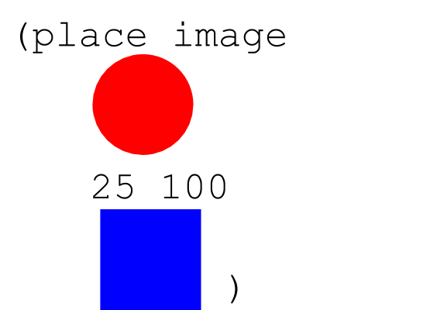
notes 2/4
is the same as...

Slide 121
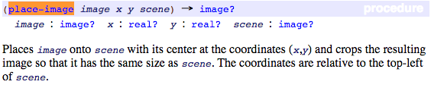
place-image

Slide 122
Today’s New Function
Here is the contract for a new function:
; rectangle: Number Number String String -> Image
Here is the purpose statement for the function:
; consumes a width, height, mode, and ; color and produces a rectangle
Here is an example of the function being used
(rectangle 300 400 “solid” “blue”)

Slide 123
Problems are made of smaller problems
Assignment 01.00 - Requirement 1: Write an expression which displays four copies of a picture in a two-by-two square, each flipped differently: the top-right one should be flipped upside down, the bottom-left one flipped sideways, and the top-left and bottom-right should be right side up.
What are the smaller problems that make up this larger problem?

Slide 124
let's remember the contracts for above and beside

Slide 125
This makes an image...
(place-image
(circle 60 "solid" "red")
150 100
(rectangle 300 200 "outline" "black"))

Slide 126
locating images relative to each other
Go to the Designing Structure Worksheet

Slide 127
Review of computer screen coordinates
How are they slightly different from math coordinates?
(0,0)
x increases to the right
y increases going down

Slide 128
computer screen coordinates
slightly different from math coordinates
(0,0)

Slide 129
What about this?
(put-image
(put-image (rectangle 500 100 "solid" "red")
250 250
(rectangle 500 100 "solid" "yellow"))
150 250
(rectangle 500 100 "solid" "black"))

Slide 130
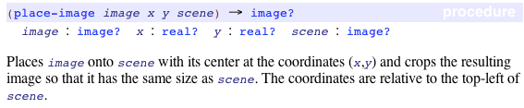
search the documentation for place-image
enter place-image into your contract library

Slide 131
what is a scene?
Enter the following code in wescheme:
(place-image
(circle 50 "solid" "red") 25 25
(rectangle 100 100 "solid" "blue"))

Slide 132
overlay/xy
for an image that is not cropped by a scene use overlay/xy
other function to incorporate in your program:
flip-horizontal, flip-vertical, scale, scale/xy, above, below, rotate, bitmap/url

Slide 133
What does it do?
(require bootstrap2012/bootstrap-teachpack)
(put-image (rectangle 500 100 "solid" "red")
250 250
(put-image (rectangle 500 100 "solid" "black")
250 150
(put-image (rectangle 500 100 "solid" "yellow")
250 50
(rectangle 500 300 "outline" "black")
)
)
)

Slide 134
notes 2/4
We can create a new identifier using the following syntax:
(define identifier value)
For example
(define x 5)
is the same as in Algebra
x = 5

Slide 135
notes 1/4
definitions window: the text box at the top of the Editor (DrRacket or WeScheme), where definitions for values and functions are written
identifier: how we refer to a function or value defined in a language (examples: +, *, star, circle)
parametrization: the process of deciding and defining the parameters

Slide 136
notes 3/4
In our programming language, variables are defined by:
(define x 4)
(define y (+ 4 9))
(define z (* x 2))
Values can be fixed (like the first example), the result of an expression (the second), or even be defined in terms of other variables (the third). We can do the same things in algebra:
x=4
y=4+9
z=x×2

Slide 137
on your hand-out: convert the code into algebra
Racket Code | Algebra
(define x 10) | x = 10
(define y (* x 2)) | y = x*2 or y=2x
(define z (+ x y))
(define age 14)
(define months (* age 12))
(define days (* months 30))
(define hours (* days 24))
(define minutes (* hours 60))

Slide 138
in Racket we define values this way:
we can even define values in terms of what has come before
(define x 4)
(define y (+ x 10))

Slide 139
8. book beside calendar
(beside book calendar)

Slide 140
10. book above calendar
(above book calendar)

Slide 141
11. book book
book book
(above
(beside book book)
(beside book book))

Slide 142
5. & 6. define variables
book and calendar
(define book
(bitmap/url "http://goo.gl/JOhWk"))
(define calendar
(bitmap/url "http://goo.gl/A1hFA"))

Slide 143
enter the following code and be prepared to discuss
1
1
(define width 100)
(define radius
(* width 1/2))
(define rc
(circle radius "solid" "red"))
3
4
6
7

Slide 144
Using Variables
How do write programs using variables?

Slide 145
notes 4/4 - Copy the example into your notebook, type the code into WeScheme and draw a picture of the output.
(place-image
(circle (/ (* 50) 2) "solid" "red")
(/ (* 50 2) 2) (/ (* 100 3) 2)
(rectangle (* 50 5) (* 50 3) "outline" "black"))

Slide 146
Writing a test
Why do we need a test for our example?

Slide 147
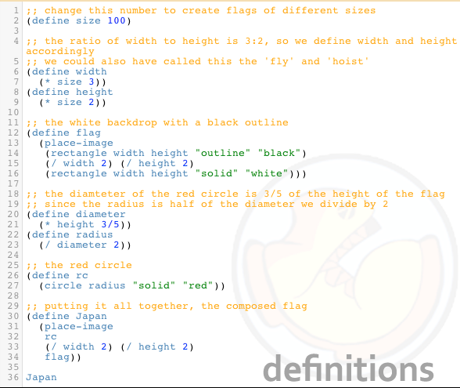
Flag of Japan Program

Slide 148
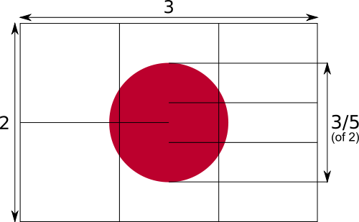
flag of japan
The width is 3 or a multiple of 3.
The height is 2 or a multiple of 2.
The diameter of the circle is three fifths of the height.

Slide 149
first we need to think about the pieces
The width is 3 or a multiple of 3.
The height is 2 or a multiple of 2.
The diameter of the circle is three fifths of the height.
A black outline
A white rectangle
A red circle

Slide 150
now we need to put it together
how does it fit together?
we place the circle onto the outline and place them both onto the white background

Slide 151
but this is a program.
Go to Japan Flag Good to see an example of program.

Slide 152
Mr. Allatta's U.S. Flag Program
Go to http://www.wescheme.org/openEditor?publicId=tCt9uyrglj
Extension: Look for a better way to create the stars.

Slide 153
lets write some code for each piece
1
;The black outlined rectangle
(rectangle 300 200 "outline" "black")
;The white solid rectangle
(rectangle 300 200 "solid" "white")
;The red solid circle
(circle 60 "solid" "red")
2
4
5
6
7

Slide 154
now that we know what to do, lets write the code
This place-image function is actually happening first.
(place-image
(circle 60 "solid" "red")
150 100
(place-image
(rectangle 300 200 "outline" "black")
150 100
(rectangle 300 200 "solid" "white")))
What is the type of value of this place-image function? An image.
This whole place-image function is the 4th parameter of the first place-image function.
What does the inside place-image function do?
What does the outside place-image function do?

Slide 155
add comments to help others understand your code
; a comment in Racket begins with a semi-colon.
; this place image-function place a red circle on a black outline, on a white background.
(place-image
(circle 60 "solid" "red")
150 100
(place-image
(rectangle 300 200 "outline" "black")
150 100
(rectangle 300 200 "solid" "white")))

Slide 156
make your own flag
write a program that displays a flag using two place-image functions. Plan your flag on the worksheet before you begin coding.

Slide 157

we want to create the following image
What do we need to know about it?
height, width, size, components

Slide 158
sqr-perim
# Header and Contract
fun sqr-perim(area :: Number) -> Number:
doc: “Consumes an area of a square and produces the perimeter”
where:
sqr-perim(4) is 8
sqr-perim(25) is 5 * 4
end
5
5
25
Notes:
Write more examples

Slide 159
sqr-perim
# Header and Contract
fun sqr-perim(area :: Number) -> Number:
doc: “Consumes an area of a square and produces the perimeter”
num-sqrt(area) * 4
where:
sqr-perim(4) is 8
sqr-perim(25) is 5 * 4
end
square root of area
square root of area
area
Notes:
Write more examples

Slide 160
sqr-perim
# Header and Contract
fun sqr-perim(area :: Number) -> Number:
doc: “Consumes an area of a square and produces the perimeter”
where:
sqr-perim(4) is 8
end
2
2
4
Notes:
Write examples

Slide 161
Step 1: Write contract and purpose statement
What is the Name of this function? How do you know?
How many inputs does it have in its Domain?
What kind of data is the Domain?
What is the Name given to this input?
What’s the Range of this function?
In your own words, what does this function do?
The Contract is a way of thinking about the function in a general way, without having to worry about exactly how it will work or how it will be used. Starting with simple questions such as these will make later steps mucheasier to think about.

Slide 162
Step 2: Give Examples
What happens to the function’s input?
Look at the two EXAMPLEs, written above.
What will happen if you type (double 5) into the interactions window? What about (double 7)?
What would happen if you changed the name of the input n to something else, such as x? What else would have to change?
Once we know a function’s contract, it becomes easy to write examples: we start by using the function with some input(s) ((double 5)), then writing in Racket code what we expect the computer to do with those inputs. (In this case, double will multiply the example input by 2.)
Now look at your two EXAMPLEs. What is the only thing that changes from one to the other?
In your workbook, circle what is changeable, or variable, between your two EXAMPLEs.
The only thing that changes is the Number being given to triple and multiplied by 3. Remember from Bootstrap 1 that once you’ve circled and labeled what changes in each example, it becomes incredibly easy to define the function! All you need to do is replace the thing that changes with its label!

Slide 163
Step 3: Define the function
Just as writing a Contract helps us write Examples, writing the Examples makes it easier to write the definition of a function. You will want to explicitly connect each step in the Design Recipe to every other step. Refer back to the Word Problem, justify each step of you Examples by referring back to the Word Problem and Contract, and finally to justify each step of the definition by referring to the Word Problem, Contract and Examples. The same variable name can be used in multiple functions, just as in math (where many functions use x as the variable name, for example)

Slide 164
double-width
Write a function called double-width, which takes in a height and a color. The function produces a solid rectangle, which is whatever height and color were passed in. Its width is twice the height.
Fill out the Contract for this function.
What is the function’s Name?
What is the function’s Domain?
What is the function’s Range?
Using the Contract you’ve written, write two Examples for the function.
What part of the Contract helps you fill in the left side of an Example?
What part of the Contract tells you what the function needs as input?
How can the Range of a function help you write the Example?
Looking at those two examples, circle the parts that are change-able, then label them with a good variable name.
Why is it helpful to choose a variable name before defining the function?
Now write the function definition, using the Examples you’ve written.

Slide 165
Write function body
# spot : String -> Image
# spot takes in a color and produces a solid circle, size 100 radius, with the color of String
import image as I
fun spot(color :: String) -> I.Image
I.circle(100, “solid”, color)
where:
spot(“blue”) is I.circle(100, “solid”, “blue”)
spot(“red”) is I.circle(100, “solid”, “red”)
end

Slide 166
Write examples
# spot : String -> Image
# spot takes in a color and produces a solid circle, size 100 radius, with the color of String
import image as I
fun spot(color :: String) -> I.Image
where:
spot(“blue”) is I.circle(100, “solid”, “blue”)
spot(“red”) is I.circle(100, “solid”, “red”)
end

Slide 167
Write function header
# spot : String -> Image
# spot takes in a color and produces a solid circle, size 100 radius, with the color of String
import image as I
fun spot(color :: String) -> I.Image
end

Slide 168
Design recipe for functions review
# spot : String -> Image
# spot takes in a color and produces a solid circle, size 100 radius, with the color of String

Slide 169
Step 1: Write contract and purpose statement
What is the Name of this function? How do you know?
How many inputs does it have in its Domain?
What kind of data is the Domain?
What is the Name given to this input?
What’s the Range of this function?
In your own words, what does this function do?
The Contract is a way of thinking about the function in a general way, without having to worry about exactly how it will work or how it will be used. Starting with simple questions such as these will make later steps mucheasier to think about.

Slide 170
Step 2: Give Examples
Step 2: Give Examples
What happens to the function’s input?
Look at the two EXAMPLEs, written above.
What will happen if you type (double 5) into the interactions window? What about (double 7)?
What would happen if you changed the name of the input n to something else, such as x? What else would have to change?
Once we know a function’s contract, it becomes easy to write examples: we start by using the function with some input(s) ((double 5)), then writing in Racket code what we expect the computer to do with those inputs. (In this case, double will multiply the example input by 2.)
Now look at your two EXAMPLEs. What is the only thing that changes from one to the other?
In your workbook, circle what is changeable, or variable, between your two EXAMPLEs.
The only thing that changes is the Number being given to triple and multiplied by 3. Remember from Bootstrap 1 that once you’ve circled and labeled what changes in each example, it becomes incredibly easy to define the function! All you need to do is replace the thing that changes with its label!

Slide 171
Step 3: Define the function
Now write the function header and body for triple. Don’t forget to replace the changing thing with a variable!
Just as writing a Contract helps us write Examples, writing the Examples makes it easier to write the definition of a function: circling what changes between the examples makes it obvious that the changeable thing is where we need to use a variable in our function. You will want to explicitly connect each step in the Design Recipe to every other step. Ask students to justify each part of their Contract by referring back to the Word Problem, to justify each step of their Examples by referring back to the Word Problem and Contract, and finally to justify each step of the definition by referring to the Word Problem, Contract and Examples. The same variable name can be used in multiple functions, just as in math (where many functions use x as the variable name, for example)
Try using the Design Recipe to solve the following word problems:
Write a function plus1, that takes in a number and adds one to it
Write a function mystery, that takes in a number and subtracts 4
Write a function red-spot, that takes in a number and draws a solid red circle, using the number as the radius

Slide 172
Lesson 01.01 - Function Design
How do we write examples that test all parts of the domain?

Slide 173
Step 1: Write contract and purpose statement
What is the Name of this function? How do you know?
How many inputs does it have in its Domain?
What kind of data is the Domain?
What is the Name given to this input?
What’s the Range of this function?
In your own words, what does this function do?
The Contract is a way of thinking about the function in a general way, without having to worry about exactly how it will work or how it will be used. Starting with simple questions such as these will make later steps mucheasier to think about.

Slide 174
Step 2: Give Examples
Step 2: Give Examples
What happens to the function’s input?
Look at the two EXAMPLEs, written above.
What will happen if you type (double 5) into the interactions window? What about (double 7)?
What would happen if you changed the name of the input n to something else, such as x? What else would have to change?
Once we know a function’s contract, it becomes easy to write examples: we start by using the function with some input(s) ((double 5)), then writing in Racket code what we expect the computer to do with those inputs. (In this case, double will multiply the example input by 2.)
Now look at your two EXAMPLEs. What is the only thing that changes from one to the other?
In your workbook, circle what is changeable, or variable, between your two EXAMPLEs.
The only thing that changes is the Number being given to triple and multiplied by 3. Remember from Bootstrap 1 that once you’ve circled and labeled what changes in each example, it becomes incredibly easy to define the function! All you need to do is replace the thing that changes with its label!

Slide 175
Step 3: Define the function
Now write the function header and body for triple. Don’t forget to replace the changing thing with a variable!
Just as writing a Contract helps us write Examples, writing the Examples makes it easier to write the definition of a function: circling what changes between the examples makes it obvious that the changeable thing is where we need to use a variable in our function. You will want to explicitly connect each step in the Design Recipe to every other step. Ask students to justify each part of their Contract by referring back to the Word Problem, to justify each step of their Examples by referring back to the Word Problem and Contract, and finally to justify each step of the definition by referring to the Word Problem, Contract and Examples. The same variable name can be used in multiple functions, just as in math (where many functions use x as the variable name, for example)
Try using the Design Recipe to solve the following word problems:
Write a function plus1, that takes in a number and adds one to it
Write a function mystery, that takes in a number and subtracts 4
Write a function red-spot, that takes in a number and draws a solid red circle, using the number as the radius

Slide 176
circle-diameter
Design a function called circle-diamter, which takes in a diameter, a mode (“solid” or “outline”) and a color and produces the appropriate circle.

Slide 177
counterchange
Design a function called counterchange, which takes in an two image and produces a four copies of that image in a two-by-two square. The copies are diagonal from each other.

Slide 178
abstraction
abstraction - generalizing patterns or removing detail to see the structure of a problem

Slide 179
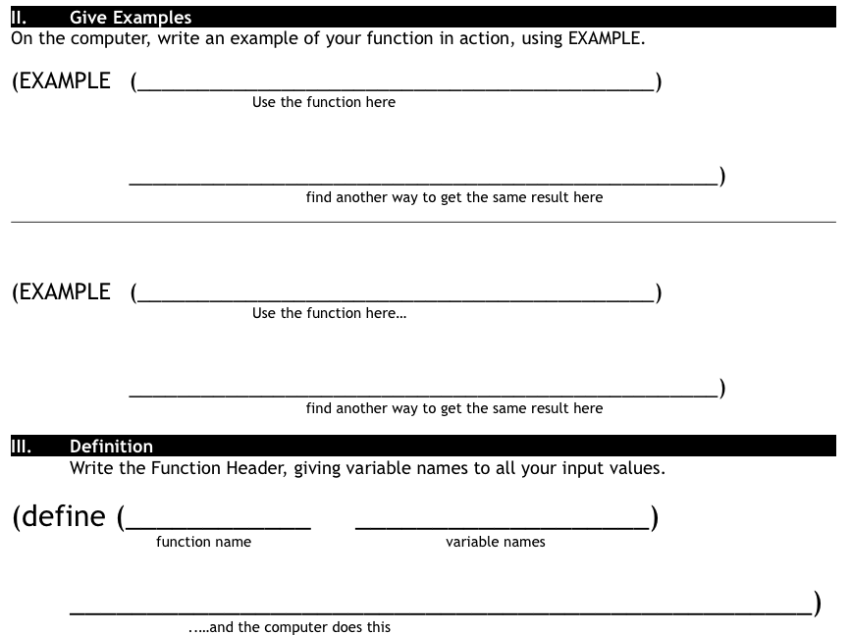
Finish the design recipe with two examples and a definition
Don't forget to circle your examples!

Slide 180
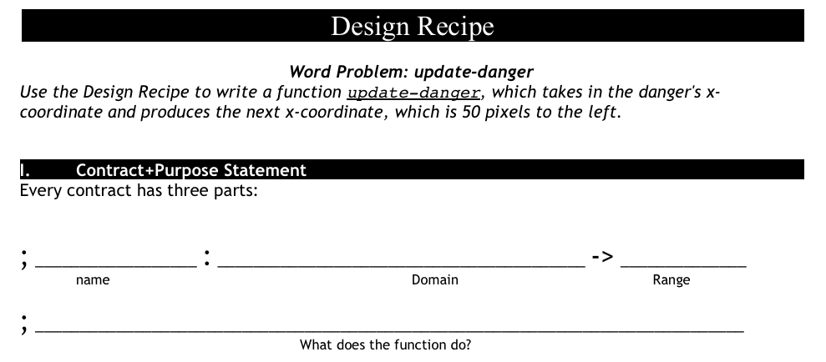
update-danger
what is the name of the function?
what are the inputs?
what are the outputs?

Slide 181
Rocket Height
Suppose we had a word problem that wanted to know how far the rocket traveled in 6 seconds: which one would we use?
What if we wanted to know how long it takes for the rocket to go a thousand miles?
What if I knew the train left at 1pm, and I wanted to know what time it arrives in Chicago, 800 miles away?
Would I want my time function, or my distance function?

Slide 182
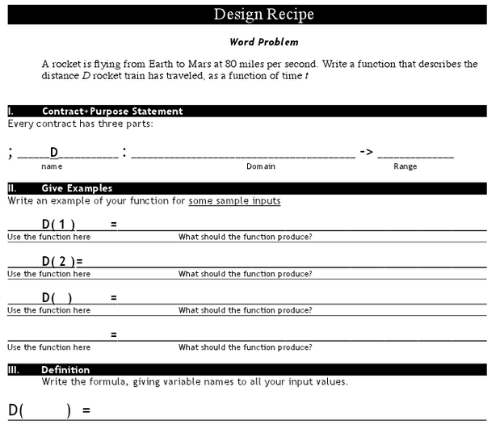
Distance

Slide 183
you also know how to define functions like this one
what is the name of this function?
(define (f x) (+ x 1))
How many variables does it take?
What is the name of that variable?
What does the function do to the variable x?
Notes:
tell me the name of this function?
How many variables does it take? What is the name of that variable?
What does the function do to the variable x?
Can you define a function g, which takes in a variable q and multiplies it by 20.

Slide 184
in algebra we define values using an equal sign
algebra
racket
and we can define values in terms of other values
x = 4
(define x 4)
y = x + 10
(define y (+ x 10))

Slide 185
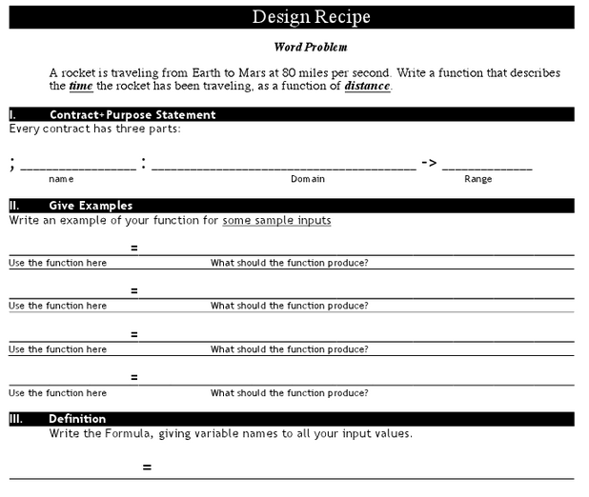

Slide 186
can you define a function g, which takes in a variable q and multiplies it by 20?
can you define a function h, which takes in a variable r and divides it by 2 then adds 5?
can you define a function f, which takes in a variable s and multiplies it by 1/3?
can you define a function g, which takes in a variable t and subtracts 13 from it?

Slide 187
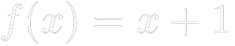
Review:
by replacing define with an equal sign
we can write
this is called functions notation.
it says the function "f of x" equals "x + 1"

Slide 188
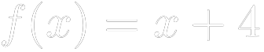

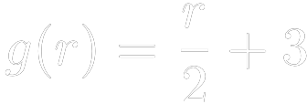
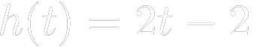
can you translate this algebra into code?
1)
2)
3)
4)

Slide 189
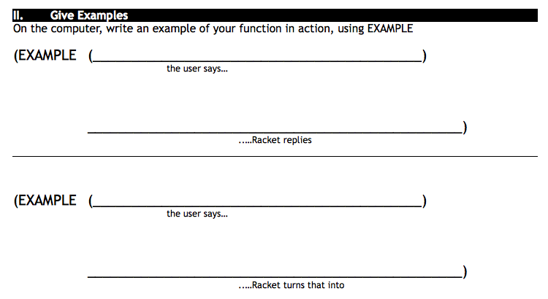
yard-area 50 60
(* 50 60)

Slide 190
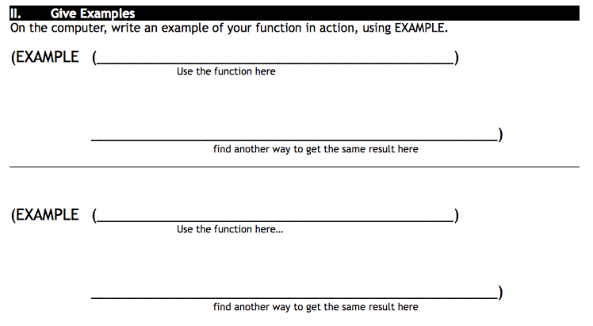

Slide 191
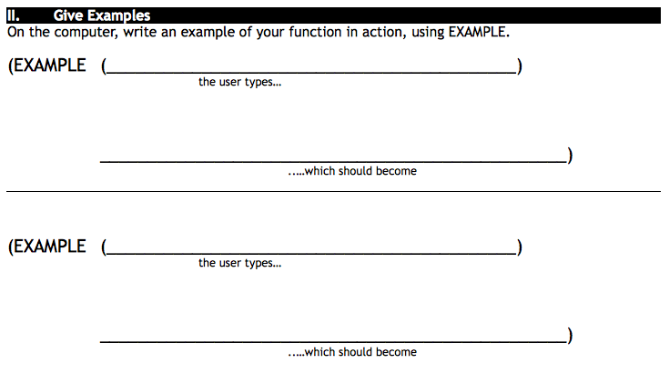
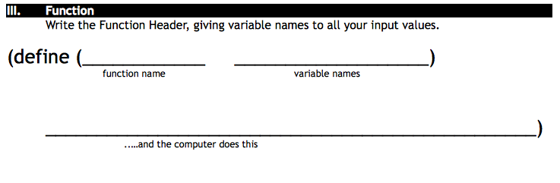

Slide 192
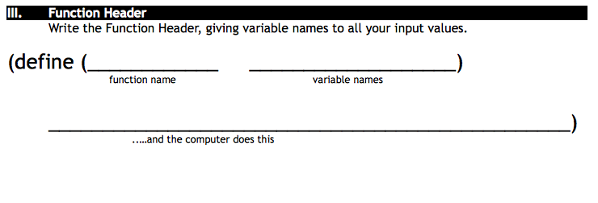

Slide 193
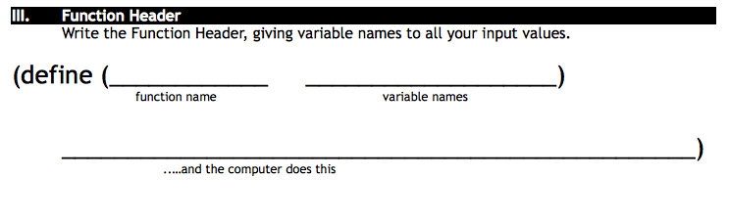

Slide 194
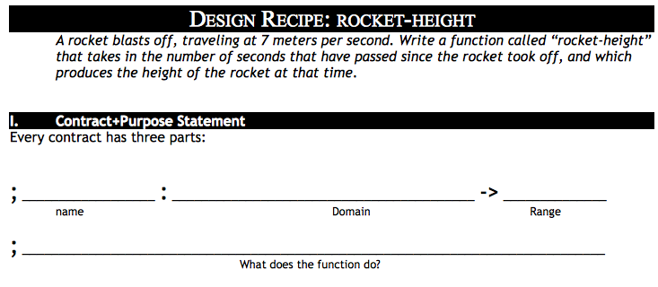

Slide 195
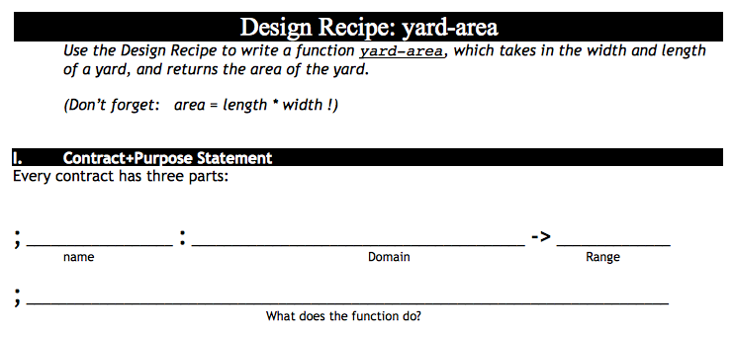
October 25th, 2012
B
Take out Lesson 4 Homework and your lesson 4 workbook
Write the contract for yard-area
Enter the contract into wescheme with your
A
Take out Lesson 4 Homework and your lesson 4 workbook
Write the contract for yard-area
Enter the contract into wescheme with your

Slide 196
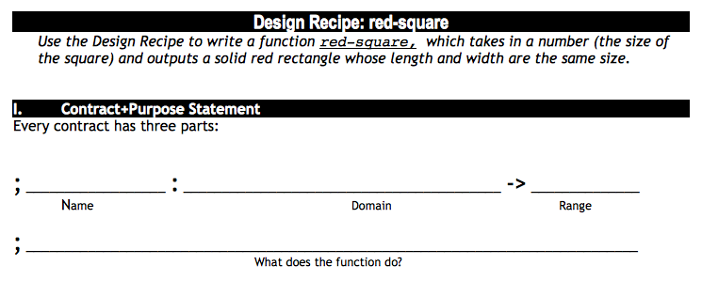

Slide 197
Tests show us how to define our functions.
A test is a way to do the same thing as our function using other functions that are already defined.
Complete the TESTS side of the worksheet.

Slide 198
let's finish this design recipe
the design recipe is a method to help us design our own functions
; double : number -> number
; takes in a number and multiplies it by 2
(check-expect (double ____) (* 20 2))
(check-expect (double 36) (* ____ ____))
(define (________ ________)
(* ________ ________))

Slide 199
Writing a test
Why do we need a test for our example?

Slide 200
Functions are like shortcuts
There is a long way to do things, but computer scientists are lazy!
Defining functions give us a shortcut for writing lots of code.

Slide 201
Defining Functions
Why do we want to write our own functions?

Slide 202
Writing examples
Look at both the contract and
purpose statement
Correct computer science type
Correct information
Complete the EXAMPLES side of the worksheet.

Slide 203
What do we need to write an example?
;rectangle: number string string -> image
If we had never seen rectangle would we be able to write an example for it? Why?

Slide 204
What is the big picture?
Design Recipe for defining functions.
Write a contract and purpose statement
Write an example and a test for that example
Look at what changed between the examples
Define the function using parameters

Slide 205
Writing Examples of Functions
What do we need to know to write an example of a function and a test from a contract and purpose statement?
Warm Up: Takes two minutes to answer the following question on your Warm Up slip:
What is the benefit of defining our own functions? Explain why you think this.

Slide 206
Double
Take a number and double it.

Slide 207
Design a functions called counterchange,
which takes in two images and produces a two by two quilt of images where the two images are facing each other on the top and bottom alternatively.

Slide 208
Design Recipe with Student Choice
How do we build confidence and feel successful with the design recipe?

Slide 209
Design a function called two-by-two,
which takes in an image and produces four copies of that image in a two-by-two square.

Slide 210
More Defining Functions
How do we define a function with multiple parameters?
Write the contract and purpose statement for red-circle.

Slide 211
Write two tests for double
(double 6)
"should be the same as"
(* 6 2)
(double 100)
"should be the same as"
(* 100 2)

Slide 212
Now write the function signature and body
(double 6)
"should be the same as"
(* 6 2)
(double 100)
"should be the same as"
(* 100 2)
(define (double number)
(* number 2))

Slide 213
Design Recipe for anything, version 0
Decide what you want to do.
Do it.
Check that you did it right.
Keep doing it.

Slide 214
Design Recipe for Functions, version 1
Write a function contract and purpose statement for the function you want to write.
Write several examples of how the function will be used, with their correct answers.
Look at what changed in your examples, that is where your parameters will go.
Write the head of the function definition.
Write the body of the function definition.

Slide 215
tests for bc
(bc 50)
"should be the same as"
(circle 50 "solid" "blue")
(bc 75)
"should be the same as"
(circle 75 "solid" "blue")

Slide 216
write a test for greenTri
(greenTri 50)
"should be a green triangle, side length 50"
(greenTri 75)
"should be a green triangle, side length 75"

Slide 217
Testing

Slide 218
circle what changes: this is where we will put our parameter
(double 6)
"should be the same as"
(* 6 2)
(double 100)
"should be the same as"
(* 100 2)

Slide 219
Blue Circle
Write a function that takes a number and returns a blue circle.

Slide 220
gt: Write a function called greenTri that takes in a number and returns a solid green triangle with the size of the parameter.
function signature
(define (gt size)
(triangle size "solid" "green"))
function body

Slide 221
Green Triangle
Write a function called greenTri that takes in a number and returns a solid green triangle with the size of the parameter.
Write a function that takes a number and gives a green triangle.

Slide 222
Can We Solve This?
Write a function called mySquare that takes in a size and returns a solid blue rectangle whose height and width are that size.

Slide 223
Work on #2!
Write a function called cc that takes in a color and returns a solid size 30 circle with that color.

Slide 224
Three Parts of Function Definition
NAME - WHAT IT'S CALLED
PARAMETER(S) - WHAT GOES IN
BODY - WHAT IS RETURNED
(define (name param)
(body_expression param))

Slide 225
How Did We Solve This Problem?
Write a function called gt that takes in a size and returns a solid green triangle with that size.
(define (gt size)
(triangle size "solid" "green"))

Slide 226
gt
function header
(define (gt side)
(triangle gt "solid" "green"))
function body

Slide 227
Double
Take a number and double it.

Slide 228
Blue Circle
Write a function that takes a number and gives back a blue circle.

Slide 229
Green Triangle
Write a function that takes a number and gives a green triangle.

Slide 230
composition of functions: putting one function inside of another
Interpret the following line of code.
(* 5 (+ 3 2))
...and this one?
(rotate 45
(triangle 50 "solid" "green"))
How many parameters does rotate have? How do we answer this question?

Slide 231
functions
all operations are functions, so + is a function.
5+4
+ takes 5, 4 and adds them

Slide 232
Finish this design recipe.
; double: Number → Number
(EXAMPLE ( )(* 20 2))
(EXAMPLE) (double 36)( ))
(define ( )
)

Slide 233
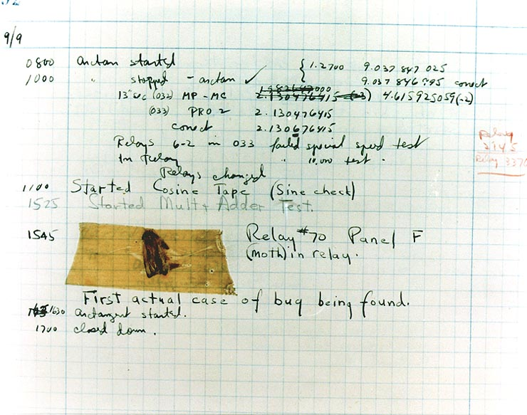
First actual case of bug being found.

Slide 234
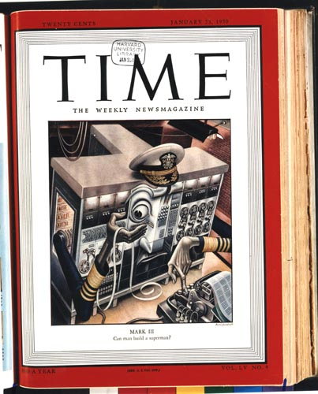
January, 1950
20¢
can man build a superman?

Slide 235
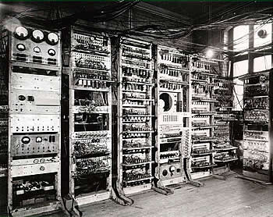
computers were once larger arrays of relay tubes--similar to light bulbs

Slide 236
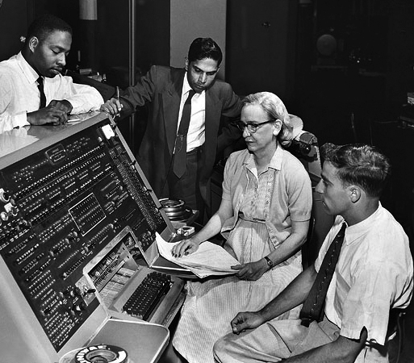
What is a bug?
Admiral Grace Hopper was one of the foremost computer scientists of her day

Slide 237
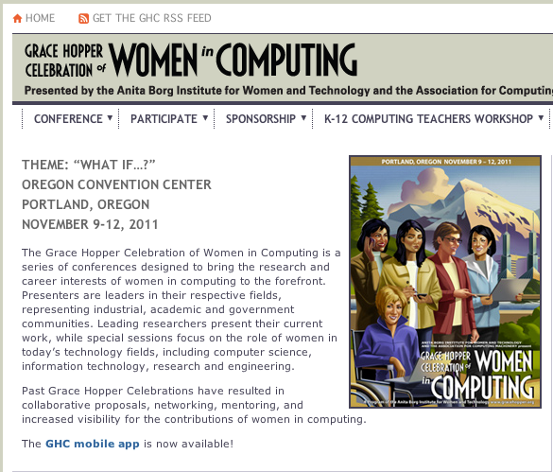
Grace Hopper Celebration of Women in Computing
Computer-scientists gather every year to honor Grace Hopper

Slide 238
Common Errors
Leaving out the beginning left-parenthesis
Leaving out the ending right-parenthesis
Misspelling the operation name
Too few or too many arguments
Putting the operation and arguments in the wrong order
Doing something different from what you meant

Slide 239
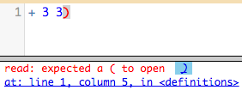
Error messages
error message: information from the computer about errors in code
How does this error message try to help you fix your program?
Write an explanation in your notes

Slide 240
Bug Finding
Directions
Open your bug program.
Click run.
Read the error message.
Fix the bug.
Click run again.
Repeat until you have found all of the bugs and the program runs without errors.
Write a sentence explaining each bug on the space provided.

Slide 241
error messages
enter the following code exactly how it is written
(circle 50 "solid" "red"
What does the message say?

Slide 242
how about this one?
(circle "solid" 50 "red")
What is the message telling us?

Slide 243
This code is broken. Can you fix it?
(define rtrr (put-image triangle 25 “solid” “red”)
50 50
(rectangle 100 100
solid”
“red”)))
What should it do?

Slide 244
World
What does the problem say about the world? What will change in our program?
Notes:
As for those aspects of the “world” that change, the problem statement mentions two. First, hitting the space bar adds a shot. Second, all the shots move straight up by one pixel per clock tick.

Slide 245
Data Representation of World
Do we know how many shots the player will “fire”?
What does this tell us about the data representation of world?

Slide 246
A List-of-shots
Since we don’t know how many shots the player will fire we use a list to represent them:
# A List-of-shots is one of:
# - empty
# - link(Shot, List-of-shots)
# interpretation: the collection of shots fired and moving straight up

Slide 247
Individual Shots
How do we represent individual shots?

Slide 248
Individual Shots
How do we represent individual shots?
# A Shot is a Number.
# interpretation the number represents the shot’s y coordinate
Notes:
The one remaining question is how to represent each individual shot. We already know that all of them have the same x coordinate and that this coordinate stays the same throughout. Furthermore, all shots look alike. Hence, their y coordinates are the only property in which they differ from each other. It therefore suffices to represent each shot as a number:
; A Shot is a Number.
; interpretation the number represents the shot's y coordinate

Slide 249
Putting this together
# A Shot-World is a List-of-Numbers.
# interpretation: each number represents the y coordinate of the shot
Notes:
After all, the above two definitions describe all list of numbers; we already have a definition for lists of numbers; and the name ShotWorld tells everyone what this class of data is about.

Slide 250
Event Handlers
Which events will we need to employ to solve the given problem?
Notes:
Once you have defined constants and developed a data representation for the states of the world, the key task is to pick which event handlers you wish to employ and to adapt their signatures to the given problem.

Slide 251
# :: Shot-World -> Image
# adds each y on w at (XSHOT, y) to the background image
fun to-image(w :: List<Number>) -> I.Image:
BACKGROUND
end
Notes:
the function that turns a world state into an image

Slide 252
# :: Shot-World -> Shot-World
# moves each shot up by one pixel
fun tock(w :: List<Number>) -> List<Number>:
w
end
Notes:
one for dealing with tick events

Slide 253
# :: Shot-World Key-Event -> Shot-World
# adds a shot to the world if the space bar was hit
fun key-press(w :: List<Number>, key :: String) -> List<Number>:
w
end
Notes:
one function for dealing with key events

Slide 254
The main function
# ShotWorld -> ShotWorld
fun main(w0):
W.big-bang(w0, [list:
W.on-tick(tock),
W.on-key(keypress),
W.to-draw(to-image)])
end
Notes:
We don’t need to design main(). It is standard form for all world programs.

Slide 255
Templates
# :: Shot-World -> Image
fun to-image(w :: List<Number>) -> I.Image:
cases (List) w:
| empty => …
| link(first, rest) =>
… first … to-image(rest)
end
end

Slide 256
to-image
first -> extracts the first y coordinate from the list
rest -> is the rest of the y coordinates
to-image(rest) -> adds each shot on w.rest to the background image
Notes:
From here it is straightforward to define the function. The key is to combine the examples with the template and to answer the questions from figure 39. Following those, you start with the base case of an empty list of shots and, from the examples, you know that the expected answer is BACKGROUND. Next you formulate what the template expressions in the second cond compute:
(first w) extracts the first coordinate from the list;
(rest w) is the rest of the coordinates; and
according to the purpose statement of the function, (to-image (rest w)) adds each shot on (rest w) to the background image.

Slide 257
to-image template
fun to-image(w :: List<Number>) -> I.Image:
cases (List) w:
| empty => …
| link(first, rest) =>
… first … to-image(rest)
end
end
Notes:
From here it is straightforward to define the function. The key is to combine the examples with the template and to answer the questions from figure 39. Following those, you start with the base case of an empty list of shots and, from the examples, you know that the expected answer is BACKGROUND. Next you formulate what the template expressions in the second cond compute:
(first w) extracts the first coordinate from the list;
(rest w) is the rest of the coordinates; and
according to the purpose statement of the function, (to-image (rest w)) adds each shot on (rest w) to the background image.

Slide 258
to-image(w.rest)
#renders the rest of the list as an image
place-image(SHOT,
XSHOT, w.first,
to-image(w.rest))
Notes:
In other words, (to-image (rest w)) renders the rest of the list as an image and thus does almost all the work. What is missing from this image is the first shot, (first w). If you now apply the purpose statement to these two expressions, you get the desired expression for the second cond clause:
(place-image SHOT XSHOTS (first w) (to-image (rest w)))

Slide 259
to-image(w.rest)
#renders the rest of the list as an image
I.place-image(SHOT,
XSHOT, w.first,
to-image(w.rest))
First image -> a constant that we defined at the beginning
Notes:
In other words, (to-image (rest w)) renders the rest of the list as an image and thus does almost all the work. What is missing from this image is the first shot, (first w). If you now apply the purpose statement to these two expressions, you get the desired expression for the second cond clause:
(place-image SHOT XSHOTS (first w) (to-image (rest w)))

Slide 260
to-image(w.rest)
#renders the rest of the list as an image
I.place-image(SHOT,
XSHOT, w.first,
to-image(w.rest))
X Coordinate of the first image -> a constant that we define at the beginning
Notes:
In other words, (to-image (rest w)) renders the rest of the list as an image and thus does almost all the work. What is missing from this image is the first shot, (first w). If you now apply the purpose statement to these two expressions, you get the desired expression for the second cond clause:
(place-image SHOT XSHOTS (first w) (to-image (rest w)))

Slide 261
to-image(w.rest)
#renders the rest of the list as an image
I.place-image(SHOT,
XSHOT, w.first,
to-image(w.rest))
The first y coordinate in the list used to place a SHOT image on the BACKGROUND
Notes:
In other words, (to-image (rest w)) renders the rest of the list as an image and thus does almost all the work. What is missing from this image is the first shot, (first w). If you now apply the purpose statement to these two expressions, you get the desired expression for the second cond clause:
(place-image SHOT XSHOTS (first w) (to-image (rest w)))

Slide 262
to-image(w.rest)
#renders the rest of the list as an image
I.place-image(SHOT,
XSHOT, w.first,
to-image(w.rest))
Adds each shot on w.rest to the background image. Basically as many nested place-image functions as their are items in the list.
Notes:
In other words, (to-image (rest w)) renders the rest of the list as an image and thus does almost all the work. What is missing from this image is the first shot, (first w). If you now apply the purpose statement to these two expressions, you get the desired expression for the second cond clause:
(place-image SHOT XSHOTS (first w) (to-image (rest w)))
The added icon is the standard image for a shot; the two coordinates are spelled out in the purpose statement; and the last argument to place-image is the image constructed from the rest of the list.

Slide 263
What about is-empty?
fun to-image(w :: List<Numbers>) -> I.Image:
ask:
| is-empty(w) then: …
| otherwise: … w.first … to-image(w.rest)
end
end
What should to-image(w.rest) produce when there are no more coordinates in the list?

Slide 264
What about keypress?
How should we structure the function keypress?

Slide 265
Your task
Add a template for tock to your program.
Follow the design recipe including examples to design the function for tock.
Finish fixing your program. You should have a program with shots that move when the space bar is pressed.

Slide 266
Challenges
After you get your program working:
If you run main, press the space bar (fire a shot), and wait for a good amount of time, the shot disappears from the canvas. When you shut down the world canvas, however, the result is a world that still contains this invisible shot.
Design an alternative tock function, which not just moves shots one pixel per clock tick but also eliminates those whose coordinates places them above the canvas. Hint: You may wish to consider the design of an auxiliary function for the recursive ask clause.
Remember extract-positives. How do we return a list with only some elements?

Slide 267
How do compilers and interpreters help develop programs?
A. They give the programmer access to specific functions designed for a specific purpose.
B. They make programs run faster.
C. They allow programmers to write programs without using machine code.

Slide 268
Constants vs. State
What changes and what stays the same?

Slide 269
Constants
import image as I
import world as W
# physical constants
HEIGHT = 300
WIDTH = 300
XSHOTS = WIDTH / 2
# graphical constants
BACKGROUND = I.empty-scene(WIDTH, HEIGHT)
SHOT = I.triangle(30, "solid", "red")

Slide 270
Constants
import image as I
import world as W
# physical constants
HEIGHT = 300
WIDTH = 300
XSHOTS = WIDTH / 2
# graphical constants
BACKGROUND = I.empty-scene(WIDTH, HEIGHT)
SHOT = I.triangle(30, "solid", "red")
What does XSHOTS represent?

Slide 271
2D Distance -> Pythagorean Theorem
In Pyret:
num-sqrt(num-sqr(A) + num-sqr(B))
To get C by itself, we take the square-root of the sum of the areas:
√(A²+B²) = C

Slide 272
Line-length
## line-length : number number -> number
## Finds 1D distance
fun line-length(num1 :: Number, num2 :: Number) -> Number:
ask:
| num1 > num2 then: num1 - num2
| num2 >= num1 then: num2 - num1
end
end

Slide 273
Distance
## distance : number number number number -> number
## Finds the 2D distance between two points
fun distance(x1 :: Number, y1 :: Number, x2 :: Number, y2 :: Number) -> Number:
num-sqrt(num-sqr(line-length(x1, x2)) + num-sqr(line-length(y1, y2)))
end

Slide 274
Collide
## collide : number number number number -> boolean
## determines whether two objects are within 50 pixels of each other
fun collide(x1, y1, x2, y2):
distance(x1, y1, x2, y2) < 80
end

Slide 275
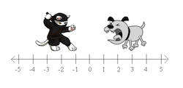
Distance along one axis -> 1D Distance
How far apart are the cat and the dog?

Slide 276
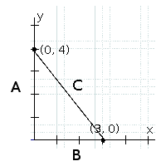
2D Distance -> Pythagorean Theorem
How could you find the length of line C?

Slide 277
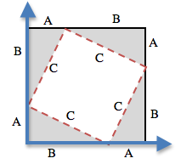
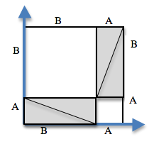
2D Distance -> Pythagorean Theorem
How could you find the length of line C?

Slide 278
2D Distance -> Pythagorean Theorem
How could you find the length of line C?
To get C by itself, we take the square-root of the sum of the areas:
√(A²+B²) = C

Slide 279
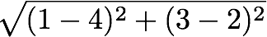
Convert the expression to circles of evaluation
The distance between the points (4, 2) and (1, 3) is given by:
sq
-
1 4

Slide 280
Collision Detection
line-length, distance, collide?

Slide 281
how to design programs?
There are two ways to go about solving this word problem:
(define (onscreen? x)
(and (> x -50) (< x 690)))
and...
(define (onscreen? x)
(and (safe-left? x) (safe-right? x)))
Notes:
Does it matter? Both will work just fine when you type them in...so why care?
There’s more to being a writer than putting down grammatically-correct sentences. There’s more to being an architect or an artist than building a bridge or coloring in a canvas. All of these disciples involved an element of design.
Likewise, there is more to being a Programmer than just writing code. You've gotten decent at writing code, and now you’re able to write sophisticated programs that include multiple functions - congratulations! But that also means you’re ready to consider what it means to design the code that you write.
The first solution puts all of the logic into one function: the left boundary and the right boundary are both tested by onscreen?. In the second solution, onscreen? uses both helper functions, each of which only tests one boundary at a time. Can you think of a reason why one might be better than another? Is it better to have a single, complex function that does all the work, or to have multiple simple functions that only do one thing apiece?
Suppose you just built a car, but it’s not working right. What would you do? Ideally, you’d like to test each part of the car (the engine, the transmission, etc) one at a time, to see which one was broken. The same is true for code! If you have a bug, it’s much easier to find when every function is simple and easy to test, and the only complex functions are just built out of simpler ones.
Another reason to like the second example is the fact that it lets programmers be lazy. Suppose you have a few characters in a videogame, all of which need to be kept on the screen. Some of them might only need safe-left?, others might only need safe-right?, and only a few might need onscreen?. What happens if the game suddenly needs to run on computers with differently-sized monitors, where the boundary is 1000 instead of 690? If you have simple and complex functions spread throughout your code, you’ll need to change them all. If your complex functions just use the simpler ones, you’d only need to change them in one place!
Badly designed programs can work just fine, but they are hard to read, hard to test, and easy to screw up if things change. As you grow and develop as a programmer, you’ll need to think beyond just "making code work". It’s not good enough if it just works - as artists, we should care about whether or not code is well designed, too.
This is what functions allow us to do! Everyone from programmers to mathematicians uses functions to carve up complex problems into simpler pieces, which make it possible to design elegant solutions to difficult problems.
So the next time you sit down to solve a problem, think about algebraic abstraction, and how you might design a beautiful solution out of simple functions, rather than a huge, complex one.

Slide 282
7 - Conditional Branching
partial functions

Slide 283
how to design programs?
There are two ways to go about solving this word problem:
(define (onscreen? x)
(and (> x -50) (< x 690)))
and...
(define (onscreen? x)
(and (safeleft? x) (saferight? x)))
Notes:
Does it matter? Both will work just fine when you type them in...so why care?
There’s more to being a writer than putting down grammatically-correct sentences. There’s more to being an architect or an artist than building a bridge or coloring in a canvas. All of these disciples involved an element of design.
Likewise, there is more to being a Programmer than just writing code. You've gotten decent at writing code, and now you’re able to write sophisticated programs that include multiple functions - congratulations! But that also means you’re ready to consider what it means to design the code that you write.
The first solution puts all of the logic into one function: the left boundary and the right boundary are both tested by onscreen?. In the second solution, onscreen? uses both helper functions, each of which only tests one boundary at a time. Can you think of a reason why one might be better than another? Is it better to have a single, complex function that does all the work, or to have multiple simple functions that only do one thing apiece?
Suppose you just built a car, but it’s not working right. What would you do? Ideally, you’d like to test each part of the car (the engine, the transmission, etc) one at a time, to see which one was broken. The same is true for code! If you have a bug, it’s much easier to find when every function is simple and easy to test, and the only complex functions are just built out of simpler ones.
Another reason to like the second example is the fact that it lets programmers be lazy. Suppose you have a few characters in a videogame, all of which need to be kept on the screen. Some of them might only need safe-left?, others might only need safe-right?, and only a few might need onscreen?. What happens if the game suddenly needs to run on computers with differently-sized monitors, where the boundary is 1000 instead of 690? If you have simple and complex functions spread throughout your code, you’ll need to change them all. If your complex functions just use the simpler ones, you’d only need to change them in one place!
Badly designed programs can work just fine, but they are hard to read, hard to test, and easy to screw up if things change. As you grow and develop as a programmer, you’ll need to think beyond just "making code work". It’s not good enough if it just works - as artists, we should care about whether or not code is well designed, too.
This is what functions allow us to do! Everyone from programmers to mathematicians uses functions to carve up complex problems into simpler pieces, which make it possible to design elegant solutions to difficult problems.
So the next time you sit down to solve a problem, think about algebraic abstraction, and how you might design a beautiful solution out of simple functions, rather than a huge, complex one.

Slide 284

estimate Sam's x coordinate
50
50
50
50
50
50
50
50
480
640

Slide 285
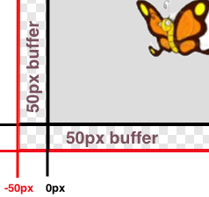
lesson 6
Sam is in a 640 x 480 yard. How far he can go to the left and right before he's out of sight?
Notes:
what data types do we know so far?
what are some functions that we know so far?
and we know how to define functions using functions in the computers language.
When Run is clicked, a window with a butterfly in it will pop up. You can use the arrow keys to move the butterfly around.
This butterfly is Sam - he’s a happy student like you! He likes to fly around outside and enjoy the fresh air.
His yard is 640 pixels wide and 480 pixels tall. If the bottom-left corner is (0, 0), what are the coordinates of the other corners?
Sam’s mom tells him that he should stay where she can see him - that means he can even step a little outside of the yard...as long as a piece of him is visible, his mom is okay.
Try moving him so he’s a little off the screen, but still safe. How far can he go?
Sometimes, however, Sam sneaks out of the box and just keeps going! He’s free! Free as a bird! (well, as a butterfly!) Look at his smile! He’s so happy to be free! Why shouldn’t he be?
Well...there’s some bad news.
Sam doesn’t realize that there’s a monster outside his yard, waiting to eat him! As long as ANY part of Sam is still in the yard, he is safe...but the moment he disappears completely his mom won’t be able to keep an eye on him!
It’s up to you to keep him safe!
Draw a 640x480 rectangle on the board to represent the screen, and have students help you identify the coordinates at the corners. Then turn students’ attention to the computers, and have them analyze the last function in the code, called onscreen?.
This file contains three function definitions. Can you find all three? What are the names of these functions?
(safe-left?, safe-right? and onscreen?)
Skit:
Have a volunteer stand up to be safe-left?. Ask them about their domain and range, and what they do according to the code (they always return true). Have students practice calling the function with sample values, then have another volunteer repeat the process as safe-right?. Finally, have a third volunteer do the same as onscreen?. Note that onscreen? must use safe-left? when evaluate an input!
The computer only talks to onscreen?, when deciding whether or not to let same keep moving. In turn, onscreen? will need to use both safe-left?and safe-right? to figure out if Sam is safe on both sides.
What are the Domain and Range of onscreen? What does the function do? What will happen when it’s given a sample input? (Answer: It calls the function ’safe-left?’ on the variable x)
We need to fix this code, to keep Sam safe. He can fly left or right and there is nothing to stop him from moving off the screen... yet!
How far can Sam go to the left before he disappears completely? (Answer: -50.) So he is onscreen as long as x is greater than -50!
Take some ideas from the class, then explain if necessary.
When the butterfly is drawn at some coordinate, it is centered at that coordinate. So if it’s drawn at 0, half of the butterfly is actually off the screen. We add the extra 50 pixels on all sides, because a piece of him is still visible as long as he is within 50 pixels of the screen’s edge.
Turn to Page 17. Take thirty seconds to fill out what we’ve discovered.
Turn to Page 18 and read the word problem for the safe-left function.
Who would like to act out safe-left? Take a volunteer.
Exercise:
According to the word problem, what’s your name? What’s your Domain? Your Range? Given Sam’s x-coordinate, and tell me if any part of him is still on the screen. Let’s try it out. "safe-left forty-five!" "safe-left three!" "safe-left negative sixty-one!" How did you know Sam was not protected at -61? because the number was not greater than -50!.
Complete the design recipe for safe-left.
Raise your hand after you complete each step.
When a team has completed the Design Recipe for safe-left, they must type in the examples and function body onto the computer.
So now we have a function that will tell us whether or not Sam is safe on the left side of the screen.
Click "Run", and try to move Sam off the left edge of the screen. Congrats! You’ve protected Sam on one side!
Unfortunately, Sam can still escape on the right hand side. We need a safe-right!
(act out with another volunteer, if necessary).
Turn to Page 19, and write another function called safe-right.
Call me over when you reach a stopping point!
Notice that even though we’ve fixed safe-right?, onscreen? won’t know about it until we change the body ofonscreen? so it calls safe-right? instead of safe-left?! Please make this change now, so that Same is safe on the right side instead of the left side.
Good job! Now we can keep Sam safe on the left side, or we can keep Sam safe on the right side. However, we don’t have a way to keep him safe on both sides! When we call onscreen? with an x-coordinate, what should it do?

Slide 286
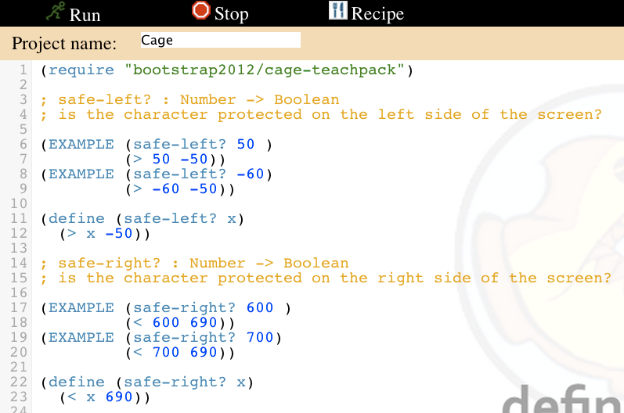
fix safe-left? and safe-right?
enter your examples
fix your definitions

Slide 287
scale your player
; scale: number image -> image
; scale/xy: number number image -> image
how can you use the scale function to scale your player?

Slide 288
find your player
search images.google.com for animated gif images
find an image not blocked by the DOE
click the image, then click full-size image
copy and paste the URL of the image into your game file

Slide 289
getting your game just right
what is the contract for bitmap/url?
how do we scale an image?
can you do anything else to your images?

Slide 290
how to write examples for update-danger
Current x-coordinate | Racket Code | Next x-coordinate
50
75
30
(- 50 50)
0
(- 75 50)
25
(- 30 50)
-20
Notes:
Animation : Racket Code -> Next x-coordinate

Slide 291
Complete the Design Recipe for update-target
paper first then type
circle examples
ask questions
use your time well

Slide 292
What is the domain of update-danger?
Number
String Number
String
Image
Number Number
Notes:
Make wrong options fade out over time, then move on. At fade out add self-reflection questions not overtly addressed in the lecture.

Slide 293
Complete the Design Recipe for update-target
paper first then type
circle examples
ask questions
use your time well

Slide 294
update-danger
what is the name of the function?
what are the inputs?
what are the outputs?

Slide 295
how to write examples for update-danger
Current x-coordinate | Racket Code | Next x-coordinate
50
75
30
(- 50 50)
0
(- 75 50)
25
(- 30 50)
-20
Notes:
Animation : Racket Code -> Next x-coordinate

Slide 296
scale your player
; scale: number image -> image
; scale/xy: number number image -> image
how can you use the scale function to scale your player

Slide 297
find your player
search images.google.com for animated gif images
find an image not blocked by the DOE
click the image, then click full-size image
copy and paste the URL of the image into your game file

Slide 298
Complete the Design Recipe for update-target
paper first then type
circle examples
ask questions
use your time well

Slide 299
how to write examples for update-danger
Current x-coordinate | Racket Code | Next x-coordinate
50
75
30
(- 50 50)
0
(- 75 50)
25
(- 30 50)
-20
Notes:
Animation : Racket Code -> Next x-coordinate

Slide 300
What is the domain of update-danger?
Number
String Number
String
Image
Number Number
Notes:
Make wrong options fade out over time, then move on. At fade out add self-reflection questions not overtly addressed in the lecture.

Slide 301
Now you have a 90, don't just satisfy the requirements. Impress me.
Here are some suggestions:
Can you make your danger move slower? faster?
Can you make your target the move other way?
(just try, you can do it)
The promotion goes to the person who goes above and beyond.

Slide 302
(0,480)
(640,480)
D
(500,300)
480
P
T
(200,240)
(550,140)
(0,0)
640
(640,0)
Notes:
What are the coordinates of the corners?
Coordinates appear clockwise from origin on click
What is the Danger's x-coordinate? Its y-coordinate?
If it is moving to the left, what is changing: the x or y coordinate? Collect data: one finger for x, two for y.
Suppose it moved to the right by 50 pixels. What are the new coordinates? (550,300)
I want my danger to always move left by 50 pixels, each time the screen is redrawn, so that it goes from (550, 300) to (500,300) to (450, 300), etc.
What if it starts at (100, 100)? Where will go next? What if it’s at (400, 600)? What if it’s off the screen, at (650, 50)? (Answer: (50, 100), (350, 600), (600,50))

Slide 303
6.
Sugar is sweet or Ice is cold.

Slide 304
4.
Sugar is sweet and Ice is hot.

Slide 305
2.
Ice is hot.

Slide 306
or
and
; and: Boolean Boolean -> Boolean
; Returns true if BOTH inputs are true
; or: Boolean Boolean -> Boolean
; Returns true if EITHER of the inputs are true.
Notes:
Sugar is sweet.
Ice is hot.
Sugar is sweet and Ice is cold.
Sugar is sweet and Ice is hot. Why is it false? Isn’t sugar still sweet?
Sugar is sweet or Ice is cold.
Sugar is sweet or Ice is hot. Why is it true? Ice isn’t hot!

Slide 307
boolean contracts
 | Function Name | Domain | Range
(> 0 5)
(= 1 9)
(<= 2 2)
(string=? "dog" "cat")

Slide 308
true or false
True or False
Mr. Allatta is wearing a tie.
Ice is hot.
Our classroom is on the 4th floor of the Washington Irving campus.
Notes:
So far, our language can only add, subtract, multiply and divide numbers. It can't compare them or decide whether something is true or false! We'll be adding the power of comparison to our language today.

Slide 309
7.
Sugar is sweet or Ice is hot.

Slide 310
5.
Sugar is sweet and Ice is hot.

Slide 311
AND OR EXAMPLES
1.
Sugar is sweet.

Slide 312
3.
Sugar is sweet and Ice is cold.

Slide 313
more booleans
how about these?
(> 0 5)
(= 1 9)
(<= 2 2)
(string=? "dog" "cat")

Slide 314
Booleans
teaching functions to compare

Slide 315
Design Recipe: cost
Luigi’s Pizza has hired you as a programmer. They offer Pepperoni ($10.50), Cheese ($9.00), Chicken ($11.25) and Broccoli ($10.25). Write a function called cost which takes in the name of a topping and outputs the cost of a pizza with that topping.
Contract+Purpose Statement
Every contract has three parts:
; __________________ : _______________________________ -> ______________
name Domain Range
;____________________________________________________________________

Slide 316
Function Header
Write the Function Header, giving variable names to all your input values.
(define (____________ ___________________)
function name variable names
(cond
))
(string=? toppings “pepperoni”)

Slide 317
Design Recipe: update-player
Write a function called update-player, which takes in the player’s y-coordinate and the name of the key pressed, and returns the new y-coordinate.
Contract+Purpose Statement
Every contract has three parts:
; __________________ : _________________________ -> ____________________
name Domain Range
Give Examples
On the computer, write an example of your function for each key, using EXAMPLE.
(EXAMPLE (____________________________) ___________________________)
Use the function here What should the function produce?
(EXAMPLE (____________________________) ___________________________)
Use the function here What should the function produce?

Slide 318
Give Examples
On the computer, write an example of your function for each topping, using EXAMPLE.
(EXAMPLE (________________________) ___________________________)
Use the function here What should the function produce?
(EXAMPLE (_________________________) ___________________________)
Use the function here What should the function produce?
(EXAMPLE (__________________________) ___________________________)
Use the function here What should the function produce?
(EXAMPLE (_________________________) ___________________________)
Use the function here What should the function produce?

Slide 319
Roles
Message Writers/Receivers
Carriers
Routers

Slide 320
Routes
Router
Message
Message
Carriers
Carriers
Message
Message
Message
Message

Slide 321
Message Senders
Write a message describing your favorite food.
Number each word of your sentence.
Write each word on a separate note card.

Slide 322
Message Senders
Place each word of your message in a separate envelope.
On the outside of the envelope write the
Destination
Number of word
Total number of words

Slide 323
Carriers
Pick up message packets one at a time.
Carry the message packet to the router.
Take a message from the router to its destination.

Slide 324
Routers
Accept packets from carriers on the left.
Hand them to carriers on the right.

Slide 325
Message Receivers
Put the packets back in order using the address on the outside of the envelope.

Slide 326
IP Addresses use binary numbers

Slide 327

Binary

Slide 328
What is binary?

Slide 329
What is binary?
A way of representing numbers using only two digits: 1 and 0.

Slide 330
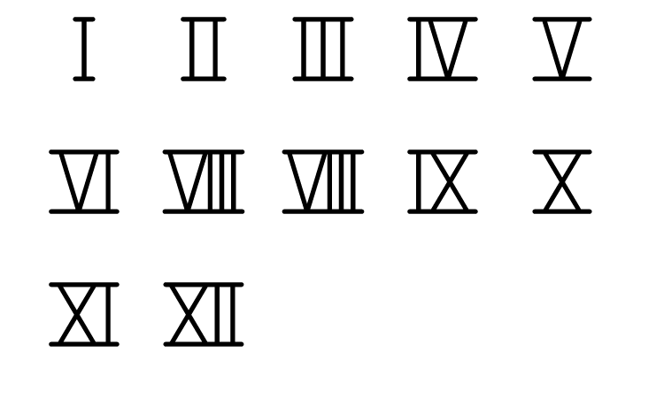
Roman Numerals
Tick Marks
Decimal Numbers
1 2 3 4 5 6 7 8 9 10 11

Slide 331
Why Use Binary?

Slide 332
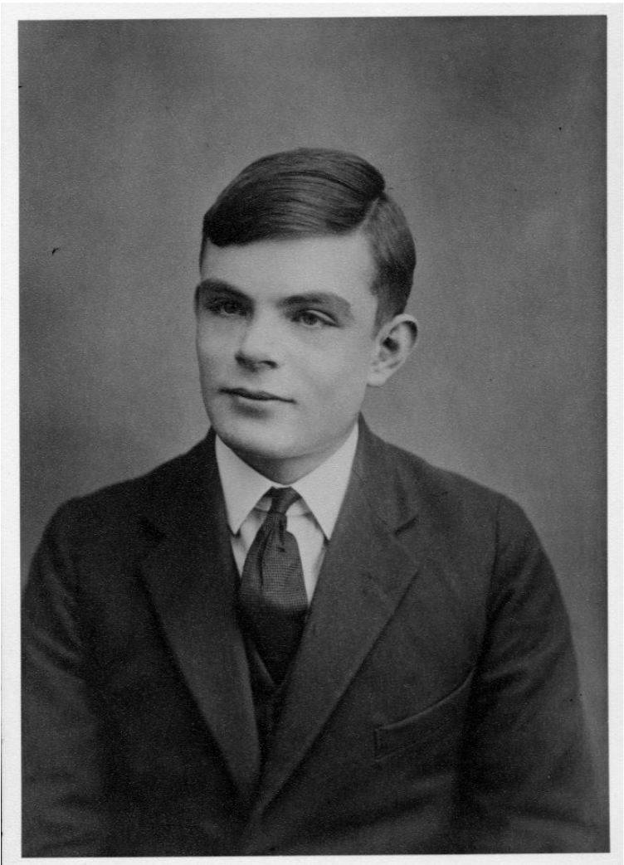
Why Use Binary?
Alan Turing showed that any function can be described by adding and subtracting binary numbers.

Slide 333
Why Use Binary?
Computers are physical machines that store and process electricity.
In every part of the machine, electricity flows through or it doesn’t flow through.
We interpret the presence of electricity as 1 and the absence of electricity as 0.

Slide 334
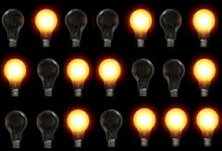
Why Use Binary?
0
1
0
0
1
0
1
1
0
1
1
0
0
1
0
0
1
0
1
1
1

Slide 335

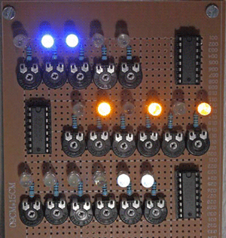



Why Use Binary?

Slide 336

Translating Binary to Decimal

Slide 337
Step 0: Make 8 Columns

Slide 338
Step 1: Make 4 Rows

Slide 339
Step 2: Powers of 2 in 2nd Row
2⁷ | 2⁶ | 2⁵ | 2⁴ | 2³ | 2² | 2¹ | 2⁰

Slide 340
Step 3: Value of Powers of 2 in 1st Row
2⁷ | 2⁶ | 2⁵ | 2⁴ | 2³ | 2² | 2¹ | 2⁰

Slide 341
Step 3: Value of Powers of 2 in 1st Row
128 | 64 | 32 | 16 | 8 | 4 | 2 | 1
2⁷ | 2⁶ | 2⁵ | 2⁴ | 2³ | 2² | 2¹ | 2⁰

Slide 342
Step 4: 0’s in 3rd Row
128 | 64 | 32 | 16 | 8 | 4 | 2 | 1
2⁷ | 2⁶ | 2⁵ | 2⁴ | 2³ | 2² | 2¹ | 2⁰
0 | 0 | 0 | 0 | 0 | 0 | 0 | 0

Slide 343

Step 5: Cut Columns in Last Row
128 | 64 | 32 | 16 | 8 | 4 | 2 | 1
2⁷ | 2⁶ | 2⁵ | 2⁴ | 2³ | 2² | 2¹ | 2⁰
0 | 0 | 0 | 0 | 0 | 0 | 0 | 0

Slide 344
Step 5: 1’s on Back of Bottom Row
128 | 64 | 32 | 16 | 8 | 4 | 2 | 1
2⁷ | 2⁶ | 2⁵ | 2⁴ | 2³ | 2² | 2¹ | 2⁰
0 | 0 | 0 | 0 | 0 | 0 | 0 | 0
1

Slide 345
Step 5: 1’s on Back of Bottom Row
128 | 64 | 32 | 16 | 8 | 4 | 2 | 1
2⁷ | 2⁶ | 2⁵ | 2⁴ | 2³ | 2² | 2¹ | 2⁰
0 | 0 | 0 | 0 | 0 | 0 | 0 | 0
1
1

Slide 346
Step 5: 1’s on Back of Bottom Row
128 | 64 | 32 | 16 | 8 | 4 | 2 | 1
2⁷ | 2⁶ | 2⁵ | 2⁴ | 2³ | 2² | 2¹ | 2⁰
0 | 0 | 0 | 0 | 0 | 0 | 0 | 0
1
1
1

Slide 347
Step 5: 1’s on Back of Bottom Row
128 | 64 | 32 | 16 | 8 | 4 | 2 | 1
2⁷ | 2⁶ | 2⁵ | 2⁴ | 2³ | 2² | 2¹ | 2⁰
0 | 0 | 0 | 0 | 0 | 0 | 0 | 0
1
1
1
1
1
1
1
1

Slide 348
How does this work?
128 | 64 | 32 | 16 | 8 | 4 | 2 | 1
2⁷ | 2⁶ | 2⁵ | 2⁴ | 2³ | 2² | 2¹ | 2⁰
0 | 0 | 0 | 0 | 0 | 0 | 0 | 0
1

Slide 349
Q0) Represent ten in binary.
128 | 64 | 32 | 16 | 8 | 4 | 2 | 1
2⁷ | 2⁶ | 2⁵ | 2⁴ | 2³ | 2² | 2¹ | 2⁰
0 | 0 | 0 | 0 | 0 | 0 | 0 | 0

Slide 350
Q0) 10 = ?
128 | 64 | 32 | 16 | 8 | 4 | 2 | 1
2⁷ | 2⁶ | 2⁵ | 2⁴ | 2³ | 2² | 2¹ | 2⁰
0 | 0 | 0 | 0 | 0 | 0 | 0 | 0

Slide 351
Q0) 10 = 8 + ?
128 | 64 | 32 | 16 | 8 | 4 | 2 | 1
2⁷ | 2⁶ | 2⁵ | 2⁴ | 2³ | 2² | 2¹ | 2⁰
0 | 0 | 0 | 0 | 0 | 0 | 0 | 0
1

Slide 352
Q0) 10 = 8 + 2
128 | 64 | 32 | 16 | 8 | 4 | 2 | 1
2⁷ | 2⁶ | 2⁵ | 2⁴ | 2³ | 2² | 2¹ | 2⁰
0 | 0 | 0 | 0 | 0 | 0 | 0 | 0
1
1

Slide 353
A0) Ten in binary is 1010!
128 | 64 | 32 | 16 | 8 | 4 | 2 | 1
2⁷ | 2⁶ | 2⁵ | 2⁴ | 2³ | 2² | 2¹ | 2⁰
0 | 0 | 0 | 0 | 0 | 0 | 0 | 0
1
1

Slide 354
Q1) Represent seventy one in binary.
128 | 64 | 32 | 16 | 8 | 4 | 2 | 1
2⁷ | 2⁶ | 2⁵ | 2⁴ | 2³ | 2² | 2¹ | 2⁰
0 | 0 | 0 | 0 | 0 | 0 | 0 | 0

Slide 355
Q1) 71 = ?
128 | 64 | 32 | 16 | 8 | 4 | 2 | 1
2⁷ | 2⁶ | 2⁵ | 2⁴ | 2³ | 2² | 2¹ | 2⁰
0 | 0 | 0 | 0 | 0 | 0 | 0 | 0

Slide 356
Q1) 71 = 64 + ?
128 | 64 | 32 | 16 | 8 | 4 | 2 | 1
2⁷ | 2⁶ | 2⁵ | 2⁴ | 2³ | 2² | 2¹ | 2⁰
0 | 0 | 0 | 0 | 0 | 0 | 0 | 0
1

Slide 357
Q1) 71 = 64 + 4 + ?
128 | 64 | 32 | 16 | 8 | 4 | 2 | 1
2⁷ | 2⁶ | 2⁵ | 2⁴ | 2³ | 2² | 2¹ | 2⁰
0 | 0 | 0 | 0 | 0 | 0 | 0 | 0
1
1

Slide 358
Q1) 71 = 64 + 4 + 2 + ?
128 | 64 | 32 | 16 | 8 | 4 | 2 | 1
2⁷ | 2⁶ | 2⁵ | 2⁴ | 2³ | 2² | 2¹ | 2⁰
0 | 0 | 0 | 0 | 0 | 0 | 0 | 0
1
1
1

Slide 359
Q1) 71 = 64 + 4 + 2 + 1
128 | 64 | 32 | 16 | 8 | 4 | 2 | 1
2⁷ | 2⁶ | 2⁵ | 2⁴ | 2³ | 2² | 2¹ | 2⁰
0 | 0 | 0 | 0 | 0 | 0 | 0 | 0
1
1
1
1

Slide 360
Q1) 71 = 64 + 4 + 2 + 1
128 | 64 | 32 | 16 | 8 | 4 | 2 | 1
2⁷ | 2⁶ | 2⁵ | 2⁴ | 2³ | 2² | 2¹ | 2⁰
0 | 0 | 0 | 0 | 0 | 0 | 0 | 0
1
1
1
1

Slide 361
A1) Seventy one in binary is 1000111
128 | 64 | 32 | 16 | 8 | 4 | 2 | 1
2⁷ | 2⁶ | 2⁵ | 2⁴ | 2³ | 2² | 2¹ | 2⁰
0 | 0 | 0 | 0 | 0 | 0 | 0 | 0
1
1
1
1

Slide 362
Q2) Represent 0b1010101 in decimal.
128 | 64 | 32 | 16 | 8 | 4 | 2 | 1
2⁷ | 2⁶ | 2⁵ | 2⁴ | 2³ | 2² | 2¹ | 2⁰
0 | 0 | 0 | 0 | 0 | 0 | 0 | 0

Slide 363
Q2) 0b1010101 = 64 + 16 + 4 + 1
128 | 64 | 32 | 16 | 8 | 4 | 2 | 1
2⁷ | 2⁶ | 2⁵ | 2⁴ | 2³ | 2² | 2¹ | 2⁰
0 | 0 | 0 | 0 | 0 | 0 | 0 | 0
1
1
1
1

Slide 364
A2) 0b1010101 = 85
128 | 64 | 32 | 16 | 8 | 4 | 2 | 1
2⁷ | 2⁶ | 2⁵ | 2⁴ | 2³ | 2² | 2¹ | 2⁰
0 | 0 | 0 | 0 | 0 | 0 | 0 | 0
1
1
1
1

Slide 365
Binary to Decimal Self Check
Q3) Represent 1 in binary.
Q4) Represent 15 in binary.
Q5) Represent 234 in binary.
Q6) Represent 0b1110 in decimal.
Q7) Represent 0b101 in decimal.
Q8) Represent 0b11 in decimal.
Q9) What is the largest decimal number that can be represented in binary with 8 bits?

Slide 366
Binary to Decimal Self Check
Q3) Represent 1 in binary…………….. 1
Q4) Represent 15 in binary………. 1111
Q5) Represent 234 in binary………11101010
Q6) Represent 0b1110 in decimal... 14
Q7) Represent 0b101 in decimal.... 5
Q8) Represent 0b11 in decimal..…. 3

Slide 367
What are we studying this week?
plor efrp hevgl

Slide 368
Substition Cypher Key
abcdefghijklmnopqrstuvwxyz
nopqrstuvwxyzabcdefghijklm

Slide 369
Slide keyboard
This is the cue to switch partners, but you shouldn’t have to move anything except the keyboard.

Slide 370
Pair programming task 0
Write an expression to display the following image.

Slide 371
Slide keyboard
This is the cue to switch partners, but you shouldn’t have to move anything except the keyboard.

Slide 372
Pair programming task 1
Write an expression to display the following image.

Slide 373
Slide keyboard
This is the cue to switch partners, but you shouldn’t have to move anything except the keyboard.

Slide 374
Pair programming task 2
Write an expression to display the following image.

Slide 375
Slide keyboard
This is the cue to switch partners, but you shouldn’t have to move anything except the keyboard.

Slide 376
Pair programming task 3
Write an expression to display the following image.

Slide 377
Slide keyboard
This is the cue to switch partners, but you shouldn’t have to move anything except the keyboard.

Slide 378
Pair programming task 4
Write an expression to display the following image.

Slide 379
Slide keyboard
This is the cue to switch partners, but you shouldn’t have to move anything except the keyboard.

Slide 380
Pair programming task 5
Write an expression to display the following image.

Slide 381
Slide keyboard

Slide 382
Pair programming task 6

Slide 383
Slide keyboard

Slide 384
Pair programming task 7

Slide 385
Slide keyboard

Slide 386
Pair programming task 8

Slide 387
Slide keyboard

Slide 388
Pair programming task 9

Slide 389
Slide keyboard

Slide 390
Pair programming task 7

Slide 391
Slide keyboard

Slide 392
Pair programming task 10

Slide 393
Slide keyboard

Slide 394
Pair programming task 12

Slide 395
Slide keyboard

Slide 396
Pair programming task 13

Slide 397
Slide keyboard

Slide 398
Pair programming task 14
I LOVE CS!

Slide 399
Slide keyboard

Slide 400
Pair programming task 15
I LOVE CS!

Slide 401
Slide keyboard

Slide 402
Pair programming task 16
Create something cool. No, do not make these words into text. No seriously.

Slide 403
Explore Task Visual Artifact
Visual Artifact
Choose one of the potential beneficial or harmful effects of the innovation you described in your previous response and use a computer to create a visual artifact related to it.
The visual artifact must be a visualization, graphic, or movie that provides additional insight to explain, clarify, or depict the beneficial or harmful effect of the innovation you selected.
Provide a written summary to describe how the visual artifact you created illustrates the benefit or harm of the innovation. (50 words max)

Slide 404
What makes a good infographic?
After exploring examples of infographics brainstorm how we could visualize the benefits and harms of social media.

Slide 405
chart junk
“The interior decoration of graphics generates a lot of ink that does not tell the viewer anything new. The purpose of decoration varies — to make the graphic appear more scientific and precise, to enliven the display, to give the designer an opportunity to exercise artistic skills. Regardless of its cause, it is all non-data-ink or redundant data-ink, and it is often chartjunk.”
Edward Tufte

Slide 406
Reading Pyret documentation
ellipse :: (
width :: Number
height :: Number
mode :: String
color :: Color
)
Constructs an ellipse with the given width, height, mode and color. Corresponds to(ellipse ...) in HtDP.

Slide 407
Pyret is a professional language
There will some differences between Pyret and Racket. For example in Racket we were able to click run and see our results in the interactions window. In Pyret we have to type it into the interactions window.

Slide 408
Pyret builds on Racket
How is Pyret different from Racket?

Slide 409
Pyret use infix syntax.
What is the opposite of an infix programming language?

Slide 410
Pyret has a cloud based REPL
What is an REPL?

Slide 411
Programmers use style conventions
What are the conventions that are used in Pyret?

Slide 412
Defining constants
You should name constants in all-capital letters unless an external convention would dictate using some other capitalization for that particular name. For example,
MY-COUNT = 100
pi = 3.1416

Slide 413
Naming
camelCase
camel-case

Slide 414
Line Length
Try to keep the total length of your lines under 80 characters.

Slide 415
Test Blocks
Outside function definitions, use check blocks for testing:
check:
1 + 1 is 2
1 + 1 is-not 0
end

Slide 416
Documentation
pyret.org/docs

Slide 417
Pull apart conditional data
cases (Animal) an-animal:
| boa(length, eats) => ...
| dillo(l, d) => ...
| tiger(n, l) => ...
end
data Animal:
| boa(length :: Number, eats :: String)
| dillo(length :: Number, dead :: Boolean)
| tiger(name :: String, length :: Number
end

Slide 418
Pull apart conditional data
cases (Animal) an-animal:
| boa(length, eats) => ...
| dillo(l, d) => ...
| tiger(n, l) => ...
end
data Animal:
| boa(length :: Number, eats :: String)
| dillo(length :: Number, dead :: Boolean)
| tiger(name :: String, length :: Number
end

Slide 419
Review Compound Data
data Animal:
| boa(length :: Number, eats :: String)
| aramadillo(length :: Number, liveness:: Boolean)
| tiger(name :: String, length :: Number)
end

Slide 420
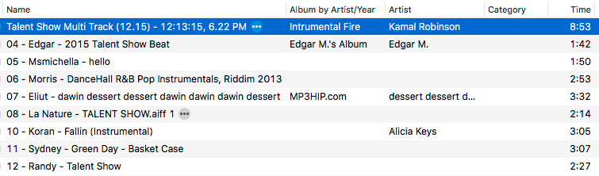
iTune
Write a data definition for an iTunesSong based on the screenshot below

Slide 421
iTunes
data iTunesSong:
| tunes(name, album, artist, category, time)
end

Slide 422
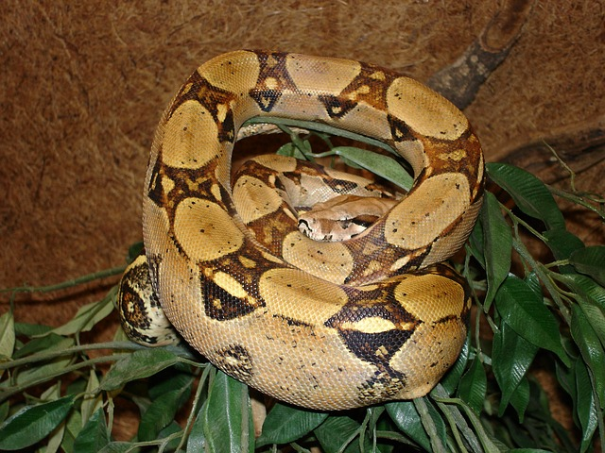
a boa is a boa(string, number, string)
data Boa:
| boa(name :: String, length :: Number, eats :: String)
end

Slide 423
a boa is a boa(string, number, string)
data Boa:
| boa(name :: String, length :: Number, eats :: String)
end
B1 = boa("Slinky", 30, "pets")
B2 = boa("Slim", 50, "homework")

Slide 424
data defintions also create functions
# boa : string number string -> boa
# aboa.name : boa -> string
# aboa.length : boa -> number
# aboa.eats: boa -> string
# is-boa: boa -> boolean

Slide 425
write 3 examples of boa-fit-cage
fun boa-fit-cage(aboa :: Boa, limit :: Number) -> Boolean:
doc: “consumes a boa and a limit and produces true if the boa will fit inside the cage, false if it will not”

Slide 426
data definitions also create functions
# boa : string number string -> boa
# aboa.name : boa -> string
# aboa.length : boa -> number
# aboa.eats: boa -> string
# is-boa: boa -> boolean

Slide 427
write 3 examples of boa-fit-cage
fun boa-fit-cage(aboa :: Boa, limit :: Number) -> Boolean:
doc: “consumes a boa and a limit and produces true if the boa will fit inside the cage, false if it will not”
fun boa-fit-cage(aboa :: Boa, limit :: Number) -> Boolean:
aboa.length <= limit
where:
boa-fit-cage(boa("Slinky", 30, "pets"), 10) is false
boa-fit-cage(boa("Slinky", 30, "pets"), 30) is true
boa-fit-cage(boa(“Slinky”, 30, “pets”), 55) is true
end

Slide 428
# a dillo is a dillo(number, boolean)
data Dillo:
| dillo(length :: Number, dead :: Boolean)
end
D1 = dillo(20, true)
D2 = dillo(5, false)

Slide 429
# hit-with-truck: dillo -> dillo
# return dead dillo one unit longer than given dillo
Define the rest of this function using the design recipe. Write a function header, examples, and a function body.

Slide 430
# hit-with-truck: dillo -> dillo
# return dead dillo one unit longer than given dillo
Define the rest of this function using the design recipe. Write a function header, examples, and a function body.

Slide 431
# a tiger is a tiger(string, number, product)
# a product is a product(string, string)
data Product:
| product(item :: String, company :: String)
end
# a tiger is a tiger(string, number, product)
data Tiger:
| tiger(name :: String, length :: Number, sells :: Product)
end

Slide 432
# a tiger is a tiger(string, number, product)
Design a function called sells-gas, which returns true if a given tiger sells gas

Slide 433
Structs practice 2 Party
# 01 Write a function called relocate, which takes in a party AND the location that it’s moving to, and makes a new party at that location. Go through each part of the design recipe: contract, examples, and definition.

Slide 434
Structs practice 2 Party
# 01 Write a function called relocate, which takes in a party AND the location that it’s moving to, and makes a new party at that location. Go through each part of the design recipe: contract, examples, and definition.

Slide 435
Structs practice 2 Party
# 00 Write a function called RSVP, which takes in a party and adds one to its number of guests.

Slide 436
Party
# a party is a (make-party String String Number)
data Party:
| party(location :: String, theme :: String, guests :: Number)
end
HALLOWEEN = party("school", "costume", 10)
SUMMER = party("beach", "luau", 7)
JULY-FOURTH = party("park", "barbecue", 12)

Slide 437
World
Writing programs means we are trying to solve a problem that we see in the world.

Slide 438
Data
Problems that we see in the world have their own data. We can define new types of data to solve any kind of problem.

Slide 439
Structs
Structs are the way we define new types of data. In Pyret they look like this:
data New-data-type:
| new-data-type(field-1, field-2, field-3)
end

Slide 440
data definition for an Auto
# an auto is an auto(String, Number, Number, String, Number)
data Auto:
| auto(model :: String, hp :: Number, rims :: Number, color :: String, value :: Number)
end
# define your cars here: model, horsepower, rims, color and price
CAR-1 = auto("M5", 480, 28, "black", 50000)
CAR-2 = auto("Prius", 160, 18, "blue", 20000)
CAR-3 = auto("taxi", 2, 20, "pink", 23)

Slide 441
Sample Problem
Design a world program that simulates firing shots. Every time the “player” hits the space bar, the program adds a shot to the bottom of the canvas. These shots rise vertically at the rate of one pixel per tick.

Slide 442
List Data
data List:
| empty
| link(first :: Item, rest :: List)
end

Slide 443
List Predicates
List data lets us check whether something is a kind of list.
We can ask
is-empty
is-link

Slide 444
We can define our own data
A list is an item linked to a list.
data Listy:
| emptily
| linky(first :: String, rest :: Listy)
end
Notes:
Add a lesson turning Luigi’s pizza activity into structs and asking for different part of struct

Slide 445
Define your own list
Write a data definition for My-List, which is either my-empty or is a my-link(first, rest)

Slide 446
Define your own list
Write a data definition for My-List, which is either my-empty or is a my-link(first, rest)
data My-List:
| my-empty
| my-link(first, rest :: My-List)
end

Slide 447
Review
What types of data have we worked with so far?
numbers, strings, images, booleans

Slide 448
Review
What types of data have we worked with so far?
numbers, strings, images, booleans
worlds, students, sneakers, boas, tigers, dillos, sneakers
Atomic Data
Compound Data
Notes:
What do all of these types of data have in common?

Slide 449
Review
All the data we have worked with had an exact size.
numbers, strings, images, booleans
worlds, students, sneakers, boas, tigers, dillos, sneakers
Fixed Size Data

Slide 450
Functions with Fixed Size Data
We used a design recipe to write functions using fixed sized data. Now we’re going to learn to design functions using any size data!

Slide 451
Arbitrary Size Data
To represent data when we don’t know how many items there are.

Slide 452
Arbitrary Size Data
To represent data when we don’t know how many items there are.
Examples: contacts, playlists, online shopping carts, rapid fire projectiles

Slide 453
Arbitrary Size Data
Simplest arbitrary size data is a list

Slide 454
Arbitrary Size Data
Simplest arbitrary size data is a list
What is the most simple list?
Notes:
What is the most simple list?

Slide 455
Empty Lists
Simplest arbitrary size data is a list
The simplest list is empty
Notes:
Show empty in Pyret

Slide 456
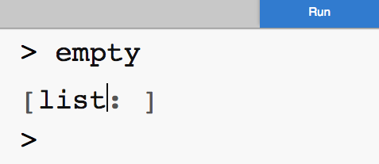
Empty Lists
empty is a value that stands for a list with nothing in it
Notes:
What is the next most simple list?

Slide 457
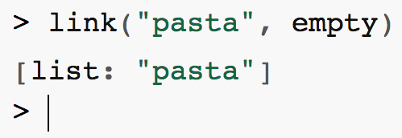
Lists are links of data
How to create a list of Mr. Allatta’s favorite foods
Notes:
What is the next most simple list?

Slide 458

We can add as many things as we want
Let’s add one more
Notes:
What is the next most simple list?

Slide 459

We can add as many things as we want
Links of links of links!
Notes:
What is the next most simple list?

Slide 460

Getting items from a list
We can get the first item from the list
Notes:
What do you think this expression will return?

Slide 461
Getting items from a list
We can get the first item from the list
Notes:
What do you think this expression will return?

Slide 462

Getting items from a list
We can get the rest of the items from the list
Notes:
What do you think this expression will return?

Slide 463
Getting items from a list
We can get the rest of the items from the list
Notes:
What do you think this expression will return?

Slide 464
Lists and World Programs
How do we design a world programs that allows the player to fire as many shots as desired?

Slide 465
Step through sum
fun sum(lonums :: List<Number>) -> Number:
cases (List) lonums:
| empty => 0
| link(first, rest) => first + sum(rest)
end
end

Slide 466
Evaluate the following example
sum([list: 4, 3, 2])
fun sum(lonums :: List<Number>) -> Number:
cases (List) lonums:
| empty => 0
| link(first, rest) => first + sum(rest)
end
end

Slide 467
Evaluate the following examples
sum([list: 4, 3, 2])
4 + sum([list: 3, 2])
fun sum(lonums :: List<Number>) -> Number:
cases (List) lonums:
| empty => 0
| link(first, rest) => first + sum(rest)
end
end

Slide 468
Evaluate the following examples
sum([list: 4, 3, 2])
4 + sum([list: 3, 2])
4 + 3 + sum([list: 2])
fun sum(lonums :: List<Number>) -> Number:
cases (List) lonums:
| empty => 0
| link(first, rest) => first + sum(rest)
end
end

Slide 469
Evaluate the following examples
sum([list: 4, 3, 2])
4 + sum([list: 3, 2])
4 + 3 + sum([list: 2])
4 + 3 + 2 + sum([list: ])
fun sum(lonums :: List<Number>) -> Number:
cases (List) lonums:
| empty => 0
| link(first, rest) => first + sum(rest)
end
end

Slide 470
Evaluate the following examples
sum([list: 4, 3, 2])
4 + sum([list: 3, 2])
4 + 3 + sum([list: 2])
4 + 3 + 2 + sum([list: ])
4 + 3 + 2 + 0
fun sum(lonums :: List<Number>) -> Number:
cases (List) lonums:
| empty => 0
| link(first, rest) => first + sum(rest)
end
end

Slide 471
Evaluate the following examples
sum([list: 4, 3, 2])
4 + sum([list: 3, 2])
4 + 3 + sum([list: 2])
4 + 3 + 2 + sum([list: ])
4 + 3 + 2 + 0
4 + 3 + 2
4 + 5
9

Slide 472
Complete the Example Stepper

Slide 473
Count
Use the design recipe to define a function called count that takes in a list and returns the number of items in the list.

Slide 474
Average
With your partner write a function called average that takes in a list of numbers and returns the average of the list.
Use the design recipe and be sure to write EXAMPLES FIRST!

